Slide 1
Docker Certified Associate Training
Source: https://docs.docker.com
Notes:
Mention the course name

Slide 2
Installation and Configuration of Docker Enterprise
Notes:
Mention the topic name and convey its importance/role in brief

Slide 3

By the end of this lesson, you will be able to:
Describe different tiers of Docker and their capabilities
Set up the repository and install the Docker Engine Enterprise
Install the UCP, DTR, and comprehend their architecture
Create grants and understand how access control works
Comprehend high availability and load balancing
Notes:
Explain the learning objectives

Slide 4
Docker Enterprise
Notes:
Docker Enterprise

Slide 5

Docker Enterprise: Overview
It is a scalable, secure, and supported container platform that helps in building and sharing legacy/modern applications. It also helps the operators to securely run them anywhere.
Applications can be built and orchestrated across platforms:
Linux
Windows Server 2016
Windows Server 2019
Notes:
Explain the content on slide using:
The Docker Enterprise platform is the leading container platform for continuous, high-velocity innovation. Docker is the only independent secure, scalable, and supported container platform that enables developers to seamlessly build and share any application — from legacy to modern — and operators to securely run them anywhere - from hybrid cloud to the edge.
Explain these three: secure, scalable, and supported container platform
building and orchestrating applications across multi-tenant Linux, Windows Server 2016, and Windows Server 2019.

Slide 6
Docker Enterprise: Overview
Docker Engine Enterprise
Docker Engine Community
Docker tiers
Docker Enterprise
Notes:
Explain the content on slide using:
Docker is available in three tiers:
Docker Engine - Community
Docker Engine - Enterprise
Docker Enterprise

Slide 7
Docker Enterprise: Overview
Docker Engine Enterprise: It is meant for enterprise development of a container runtime. While developing containers the security and an enterprise grade SLA are kept in mind.
Purpose
Docker Enterprise: It is meant for enterprise development as well as for IT teams who build, ship, and run business critical applications in production at scale.
Notes:
Explain the content on slide using:
Docker Engine - Enterprise is designed for enterprise development of a container runtime with security and an enterprise grade SLA in mind.
Docker Enterprise is designed for enterprise development and IT teams who build, ship, and run business critical applications in production at scale.

Slide 8
Docker Enterprise: Overview
Capabilities | Docker Engine - Community | Docker Engine - Enterprise | Docker Enterprise
Container engine and built in networking, orchestration, and security | Yes | Yes | Yes
Certified infrastructure, plugins, and ISV containers | - | Yes | Yes
Image management | - | - | Yes
Container app management | - | - | Yes
Image security scanning | - | - | Yes
Notes:
Explain the capabilities of different tiers

Slide 9
Docker Enterprise: Overview
Applications can be built and orchestrated across:
Linux
Windows Server 2016
Platforms
Windows Server 2019
Notes:
Explain the applications using:
The Docker Enterprise platform is the leading container platform for continuous, high-velocity innovation. Docker is the only independent secure, scalable, and supported container platform that enables developers to seamlessly build and share any application — from legacy to modern — and operators to securely run them anywhere - from hybrid cloud to the edge.
building and orchestrating applications across multi-tenant Linux, Windows Server 2016, and Windows Server 2019.

Slide 10
Docker Enterprise: Overview
Workloads are deployed using:
Docker Kubernetes Service
Features
Docker Swarm
Notes:
list the features:
Docker Enterprise enables deploying highly available workloads using either the Docker Kubernetes Service or Docker Swarm

Slide 11
Docker Enterprise: Overview
Tasks that are required by orchestration and are automated by Docker Enterprise, like provisioning:
Containers
Pods
Cluster resources
Notes:
List the tasks:
Docker Enterprise automates many of the tasks that orchestration requires, like provisioning pods, containers, and cluster resources

Slide 12
Features of Docker Enterprise
Notes:
Features of Docker Enterprise

Slide 13
Docker Enterprise : Features
Image scanning and signing enforcement policies
Features of Docker Enterprise
LDAP/AD integration
Security policies
Role-based access control
Notes:
Explain features

Slide 14
Docker Enterprise: Features
Image scanning and signing of Swarm images and Docker Apps
2
1
Secure supply chain attributes
3
DTR support for the Docker App format
Image promotion
Notes:
Explain attributes:
DTR support for the Docker App format, based on the CNAB specification
Note: Docker Apps can be deployed to clusters managed by UCP, where they will be displayed as Stacks
Image signing and scanning of Swarm images (kubernetes images) and Docker Apps for validating and verifying content
Image promotion with mirroring between registries as well as Docker Hub

Slide 15
Docker Enterprise: Features
By using Docker, thousands of physical or virtual machines can be joined to create cluster.
Docker Enterprise deploys the applications at scale.
Docker Enterprise makes management of the cluster from a centralized place very easy.
Docker Enterprise manages and monitors the container cluster by using a graphical web interface.
Notes:
Explain features:
Centralized cluster management:
With Docker, you can join thousands of physical or virtual machines together to create a cluster, allowing you to deploy your applications at scale. Docker Enterprise extends the functionality provided by Docker Engine to make it easier to manage your cluster from a centralized place.
You can manage and monitor your container cluster using a graphical web interface.

Slide 16
Docker Enterprise: Features
Deploy, manage, and monitor:
Docker Enterprise is used to deploy and monitor the applications and services.
Docker Enterprise manages the following infrastructure resources from a central console:
Nodes
Volumes
Networks, from a central console.
Notes:
Explain features:
Deploy, manage, and monitor:
With Docker Enterprise, you can manage all of the infrastructure resources you have available, like nodes, volumes, and networks, from a central console.
You can also deploy and monitor your applications and services.

Slide 17
Docker Enterprise: Features
Built-in security and access control:
Docker Enterprise has a built-in authentication mechanism with role-based access control (RBAC) in order to control access and edit permissions for cluster and applications.
Docker Enterprise authentication gets integrated with LDAP services and supports SAML SCIM to proactively synchronize with authentication providers.
Notes:
Explain featuress:
Built-in security and access control
Docker Enterprise has its own built-in authentication mechanism with role-based access control (RBAC), so that you can control who can access and make changes to your cluster and applications. Also, Docker Enterprise authentication integrates with LDAP services and supports SAML SCIM to proactively synchronize with authentication providers. You can also opt to enable PKI authentication to use client certificates, rather than username and password.

Slide 18
Kubernetes Services
Features of Docker Kubernetes Services:
Kubernetes orchestration
CNCF certified Kubernetes conformance
Kubernetes app deployment
Compose stack deployment
Role-based access control
Blue-green deployments
Ingress controllers
Pod Security Policies
Container Storage Interface (CSI) support
iSCSI support for Kubernetes
Non-disruptive Docker Enterprise platform upgrades
Experimental features, such as Kubernetes-native ingress (Istio)
Notes:
Explain the content on slide using:
Docker Enterprise provides multi-architecture orchestration using the Docker Kubernetes Service.
Docker Kubernetes Services features include:
Kubernetes orchestration full feature set
CNCF Certified Kubernetes conformance
Kubernetes app deployment via UCP web UI or CLI (kubectl)
Compose stack deployment for Swarm and Kubernetes apps (docker stack deploy)
Role-based access control for Kubernetes workloads
Blue-Green deployments, for load balancing to different app versions
Ingress Controllers with Kubernetes L7 routing
Pod Security Policies to define a set of conditions that a pod must run with in order to be accepted into the system
Note: Pod Security Policies are currently Beta status in Kubernetes 1.14
Container Storage Interface (CSI) support
iSCSI support for Kubernetes
Non-disruptive Docker Enterprise platform upgrades (blue-green upgrades)
Experimental features (planned for full GA in subsequent Docker Enterprise releases):
Kubernetes-native ingress (Istio)

Slide 19
Kubernetes Services
Integration of UCP with Kubernetes enables:
Authenticating the user client bundle certificates
Authorizing the requests using the UCP role-based access control model
Assigning the nodes to a namespace by injecting a NodeSelector automatically
Maintaining all the nodes in the orchestrator inventories of Kubernetes and Swarm
Preventing access control and privilege escalation without the PodSecurityPolicy admission controller
Resolving images of deployed workloads automatically
Accepting or rejecting images depending on UCP’s signing-policy feature
Notes:
Explain the content on slide using:
In addition, UCP integrates with Kubernetes by using admission controllers, which enable:
Authenticating user client bundle certificates when communicating directly with the Kubernetes API server
Authorizing requests via the UCP role-based access control model
Assigning nodes to a namespace by injecting a NodeSelector automatically to workloads via admission control
Keeping all nodes in both Kubernetes and Swarm orchestrator inventories
Fine-grained access control and privilege escalation prevention without the PodSecurityPolicy admission controller
Resolving images of deployed workloads automatically, and accepting or rejecting images based on UCP’s signing-policy feature

Slide 20
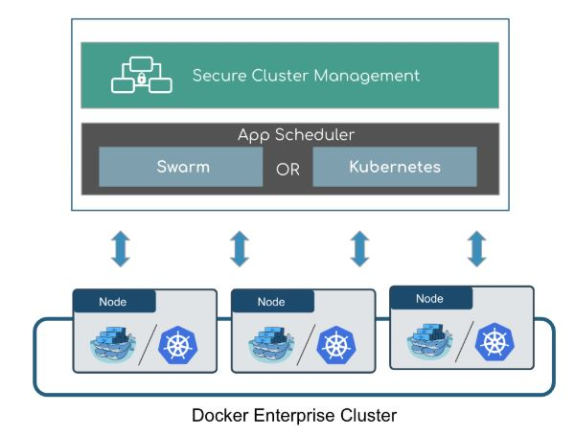
Orchestration
Docker Enterprise Orchestration:
Source: https://docs.docker.com/ee/#orchestration-platform-features
Notes:
Explain the diagram

Slide 21
Orchestration
Docker Enterprise platform allows to run both Swarm and Kubernetes in the same cluster.
There is no need for the developers to select orchestrators.
There is freedom to change orchestrators according to the requirement.
The Enterprise manager nodes are enabled with both Swarm and Kubernetes.
The worker node is both Kubernetes API- ready and Swarm API- ready.
Source: https://docs.docker.com/ee/#orchestration-platform-features
Notes:
Explain orchestration

Slide 22
Orchestration
Orchestration platform features:
Enabling high availability using Docker Enterprise manager nodes
Allocating worker nodes for Swarm/Kubernetes workloads
Monitoring apps via a single pane of glass
Enhancing Swarm hostname routing mesh with Interlock 2.0
One platform-wide management plane:
Secure software supply chain
Secure multi-tenancy
Secure and highly available node management
Notes:
explain platform features

Slide 23
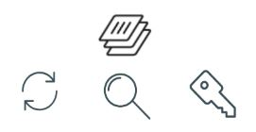
Security Features
Docker Enterprise security features for Kubernetes apps:
Image signing and scanning
Source: https://docs.docker.com/ee/#secure-supply-chain
Notes:
Explain security features

Slide 24
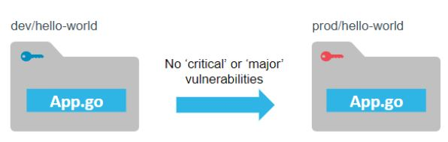
Security Features
Docker Enterprise security features for Kubernetes apps:
Policies for automating image promotions
Source: https://docs.docker.com/ee/#secure-supply-chain
Notes:
Explain security features

Slide 25
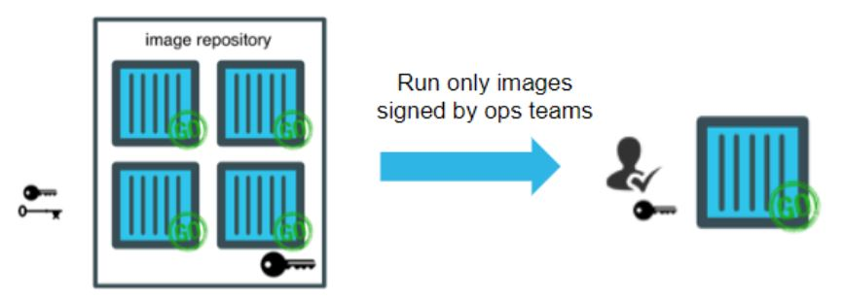
Security Features
Docker Enterprise security features for Kubernetes apps:
Content trust policy enforcement
Source: https://docs.docker.com/ee/#secure-supply-chain
Notes:
Explain security features

Slide 26
Docker Enterprise Installation: Repository
Notes:
Docker enterprise installation: repository

Slide 27
Installation
Prerequisite steps:
Go to https://hub.docker.com/my-content
Create an account
Subscribe to the Docker Enterprise trial
Open the profile and choose My Content
Click on Setup
Copy the URL from the field labeled Copy and paste this URL to download your Edition
Use the URL <DOCKER-EE-URL>
Using repository
Installation methods
Using package
Notes:
Perform the steps and explain the content

Slide 28
Install Docker Enterprise
Problem Statement: Your manager has asked you to install Docker Enterprise on your Ubuntu machine which can be later used by your company for commercial application.
Steps to Perform:
Get Docker Enterprise Trial.
Set up the Docker repository.
Install Docker Engine - Enterprise.

Slide 29
Docker Enterprise Installation: Package
Notes:
Docker enterprise installation: Package

Slide 30
Installation Using Package
Install Docker Enterprise using package:
Go to the Docker Enterprise repository URL associated with the trial or subscription in the browser.
Go to ubuntu/x86_64/stable-<VERSION> and download the .deb file for the Docker Enterprise version and architecture you want to install.
Download the .deb file for your release and install it manually
$ sudo dpkg -i /path/to/package.deb
Install Docker Enterprise by changing the path to the path where the Docker Enterprise package is downloaded
Verify that Docker Enterprise is installed correctly by running the hello-world image
$ sudo docker run hello-world
Notes:
Perform the steps
Install from a package
If you cannot use Docker’s repository to install Docker EE, you can download the .deb file for your release and install it manually. You need to download a new file each time you want to upgrade Docker EE.
Go to the Docker EE repository URL associated with your trial or subscription in your browser. Go to ubuntu/x86_64/stable-<VERSION> and download the .deb file for the Docker EE version and architecture you want to install.
Install Docker EE, changing the path below to the path where you downloaded the Docker EE package.
$ sudo dpkg -i /path/to/package.deb
The Docker daemon starts automatically.
Verify that Docker EE is installed correctly by running the hello-world image.
$ sudo docker run hello-world
This command downloads a test image and runs it in a container. When the container runs, it prints an informational message and exits.
Docker EE is installed and running. The docker group is created but no users are added to it. You need to use sudo to run Docker commands.

Slide 31
Uninstall Docker Enterprise
Notes:
Uninstall docker enterprise

Slide 32
Uninstall
Uninstall Docker Enterprise :
Uninstall the Docker EE package
$ sudo apt-get purge docker-ee
Delete all the images, containers, and volumes
$ sudo rm -rf /var/lib/docker
Note: The desired edited configuration files must be deleted manually
Notes:
Perform the steps
Uninstall Docker EE
Uninstall the Docker EE package:
$ sudo apt-get purge docker-ee
Images, containers, volumes, or customized configuration files on your host are not automatically removed. To delete all images, containers, and volumes:
$ sudo rm -rf /var/lib/docker
.

Slide 33
Post-Installation Steps for Linux
Notes:
Post-installation step

Slide 34
Post-Installation Procedures
Configure the default logging driver
Use a different storage engine
Configure where the Docker daemon listens for connections
Procedures
Configure a Docker to start on boot
Enable an IPv6 on the Docker daemon
Manage Docker as a non-root user
Troubleshoot issues
Notes:
Explain the types of post-installation procedures
Manage Docker as a non-root user
Configure Docker to start on boot
Use a different storage engine
Configure default logging driver
Configure where the Docker daemon listens for connections
Enable IPv6 on the Docker daemon
Troubleshooting

Slide 35
Universal Control Plane (UCP)
Notes:
UCP

Slide 36
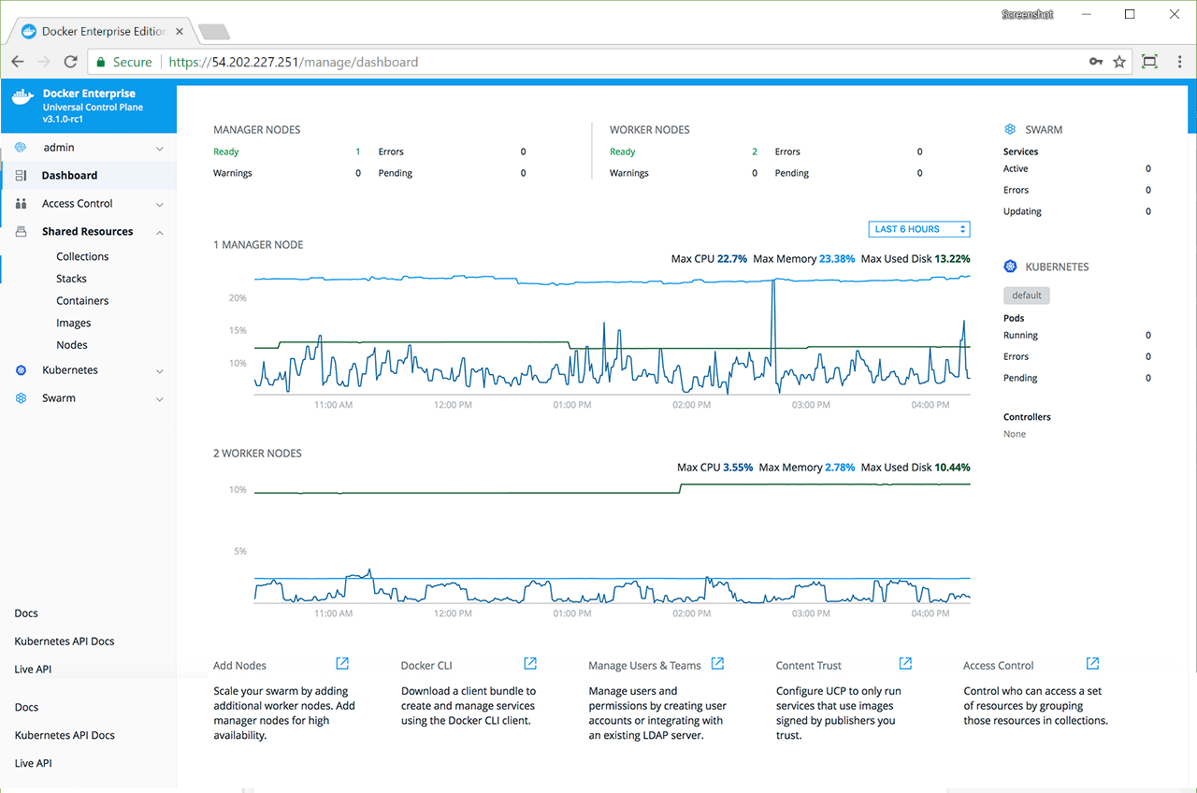
UCP: Overview
Universal Control Plane is the cluster management solution from Docker Enterprise. This is installed on-premise or on a virtual private cloud. UCP helps in managing the applications and Docker cluster through a single interface.
Source: https://docs.docker.com/ee/ucp/
Notes:
Explain UCP
Docker Universal Control Plane (UCP) is the enterprise-grade cluster management solution from Docker. You install it on-premises or in your virtual private cloud, and it helps you manage your Docker cluster and applications through a single interface.
Zoom-in to show the image

Slide 37
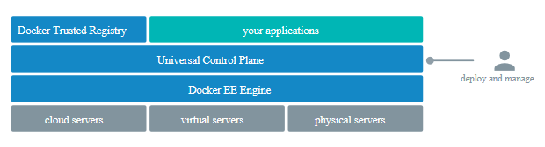
UCP: Architecture
After the deployment of a Universal Control Plane (UCP) instance, the developers and IT operations cannot interact with Docker Engine directly. They can interact with UCP.
Source: https://docs.docker.com/ee/ucp/ucp-architecture/
Notes:
Explain UPC architecture
Once Universal Control Plane (UCP) instance is deployed, developers and IT operations no longer interact with Docker Engine directly, but interact with UCP instead. Since UCP exposes the standard Docker API, this is all done transparently, so that you can use the tools you already know and love, like the Docker CLI client and Docker Compose.

Slide 38
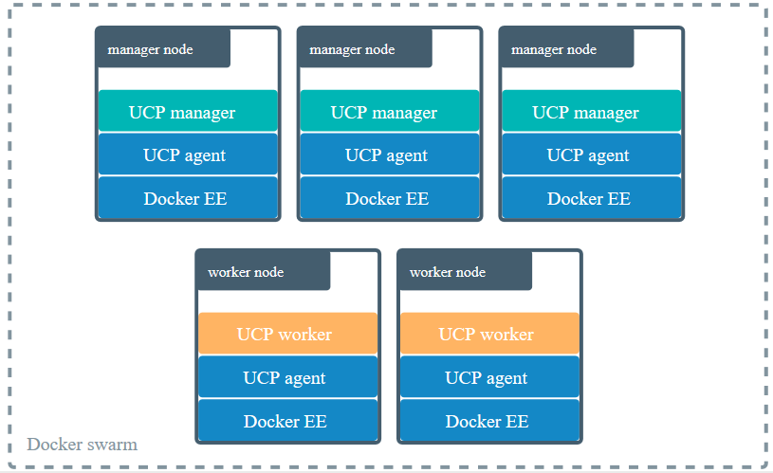
UCP: Architecture
The clustering and orchestration functionality is leveraged by Docker UCP.
Source: https://docs.docker.com/ee/ucp/ucp-architecture/
Notes:
Explain UCP architecture
Docker UCP leverages the clustering and orchestration functionality provided by Docker
A swarm is a collection of nodes that are in the same Docker cluster. Nodes in a Docker swarm operate in one of two modes: Manager or Worker. If nodes are not already running in a swarm when installing UCP, nodes will be configured to run in swarm mode.
When you deploy UCP, it starts running a globally scheduled service called ucp-agent. This service monitors the node where it’s running and starts and stops UCP services, based on whether the node is a manager or a worker node.
If the node is a:
Manager: the ucp-agent service automatically starts serving all UCP components, including the UCP web UI and data stores used by UCP. The ucp-agent accomplishes this by deploying several containers on the node. By promoting a node to manager, UCP automatically becomes highly available and fault tolerant.
Worker: on worker nodes, the ucp-agent service starts serving a proxy service that ensures only authorized users and other UCP services can run Docker commands in that node. The ucp-agent deploys a subset of containers on worker nodes.

Slide 39
UCP: Architecture
Docker swarm is a collection of nodes. Nodes operate in one of the two modes.
Source: https://docs.docker.com/ee/ucp/ucp-architecture/
Notes:
Explain UCP architecture
Docker UCP leverages the clustering and orchestration functionality provided by Docker
A swarm is a collection of nodes that are in the same Docker cluster. Nodes in a Docker swarm operate in one of two modes: Manager or Worker. If nodes are not already running in a swarm when installing UCP, nodes will be configured to run in swarm mode.

Slide 40
UCP: Architecture
On manager nodes, the ucp-agent serves all the UCP components.
It is a globally scheduled service.
Source: https://docs.docker.com/ee/ucp/ucp-architecture/
Notes:
Explain UCP architecture
When you deploy UCP, it starts running a globally scheduled service called ucp-agent. This service monitors the node where it’s running and starts and stops UCP services, based on whether the node is a manager or a worker node.
If the node is a:
Manager: the ucp-agent service automatically starts serving all UCP components, including the UCP web UI and data stores used by UCP. The ucp-agent accomplishes this by deploying several containers on the node. By promoting a node to manager, UCP automatically becomes highly available and fault tolerant.
Worker: on worker nodes, the ucp-agent service starts serving a proxy service that ensures only authorized users and other UCP services can run Docker commands in that node. The ucp-agent deploys a subset of containers on worker nodes.

Slide 41
UCP: Architecture
On worker nodes, the ucp-agent starts serving a proxy service.
Source: https://docs.docker.com/ee/ucp/ucp-architecture/
Notes:
Explain UCP architecture
When you deploy UCP, it starts running a globally scheduled service called ucp-agent. This service monitors the node where it’s running and starts and stops UCP services, based on whether the node is a manager or a worker node.
If the node is a:
Manager: the ucp-agent service automatically starts serving all UCP components, including the UCP web UI and data stores used by UCP. The ucp-agent accomplishes this by deploying several containers on the node. By promoting a node to manager, UCP automatically becomes highly available and fault tolerant.
Worker: on worker nodes, the ucp-agent service starts serving a proxy service that ensures only authorized users and other UCP services can run Docker commands in that node. The ucp-agent deploys a subset of containers on worker nodes.

Slide 42
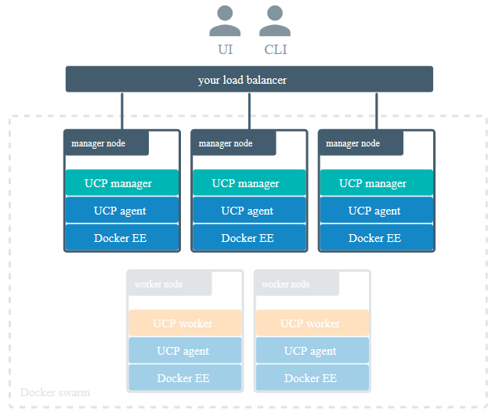

Interaction with UCP
Source: https://docs.docker.com/ee/ucp/ucp-architecture/
Notes:
Explain interaction with UCP
There are two ways to interact with UCP: the web UI or the CLI.
You can use the UCP web UI to manage your swarm, grant and revoke user permissions, deploy, configure, manage, and monitor your applications.
UCP also exposes the standard Docker API, so you can continue using existing tools like the Docker CLI client. Since UCP secures your cluster with role-based access control, you need to configure your Docker CLI client and other client tools to authenticate your requests using client certificates that you can download from your UCP profile page

Slide 43
Installation of UCP
Notes:
Installation of UCP

Slide 44
Installation
Minimum requirements:
8GB of RAM is required for manager nodes
4GB of RAM is required for worker nodes
2 vCPUs are required for manager nodes
10GB of free disk space is required for the /var partition for manager nodes
500MB of free disk space is required for the /var partition for worker nodes
Recommended requirements:
16GB of RAM required for manager nodes
4 vCPUs required for manager nodes
25-100GB of free disk space
Notes:
Explain the requirements
Minimum requirements:
8GB of RAM for manager nodes
4GB of RAM for worker nodes
2 vCPUs for manager nodes
10GB of free disk space for the /var partition for manager nodes (A minimum of 6GB is recommended.)
500MB of free disk space for the /var partition for worker nodes
Recommended requirements:
16GB of RAM for manager nodes
4 vCPUs for manager nodes
25-100GB of free disk space

Slide 45
Installation
Hardware and software requirements:
Docker Engine Enterprise version 19.03 is required.
Linux kernel version 3.10 or higher is required.
A static IP address for each node in the cluster is required.
Traffic:
Scope of the port: It’s the incoming traffic from a set of hosts.
Types of scope:
External: Traffic that arrives from outside of the cluster through the end-user interaction
Internal: Traffic that arrives from other hosts in the same cluster
Self: Traffic that arrives to the port only from the processes that are occuring on the same host
Notes:
Explain the requirements and traffic
Hardware and software requirements
You can install UCP on-premises or on a cloud provider. Common requirements:
Docker Engine - Enterprise version 19.03
Linux kernel version 3.10 or higher
A static IP address for each node in the cluster
Minimum requirements
8GB of RAM for manager nodes
4GB of RAM for worker nodes
2 vCPUs for manager nodes
10GB of free disk space for the /var partition for manager nodes (A minimum of 6GB is recommended.)
500MB of free disk space for the /var partition for worker nodes
Ports used
When installing UCP on a host, a series of ports need to be opened to incoming traffic. Each of these ports will expect incoming traffic from a set of hosts, indicated as the “Scope” of that port. The three scopes are:
External: Traffic arrives from outside the cluster through end-user interaction.
Internal: Traffic arrives from other hosts in the same cluster.
Self: Traffic arrives to that port only from processes on the same host.

Slide 46
Installation
Following ports must be kept open for incoming traffic:
TCP 179 | TCP 443 | TCP 2376 | TCP 2377 | UDP 4789
TCP 6443 | TCP 6444 | TCP, UDP 7946 | TCP 9099 | TCP 10250
TCP 12376 | TCP 12378 | TCP 12379 | TCP 12380 | TCP 12381
TCP 12382 | TCP 12383 | TCP 12384 | TCP 12385 | TCP 12386
TCP 12388
Disabling CLOUD_NETCONGIF_MANAGE before installing UCP:
Set the following parameter in the network interface configuration file, `/etc/sysconfig/network/ifcfg-eth0`:
``` CLOUD_NETCONFIG_MANAGE="no“
```
2. Run `service network restart`.
Notes:
List the port and their purpose.
Explain why disabling is required.
Disable CLOUD_NETCONFIG_MANAGE for SLES 15
For SUSE Linux Enterprise Server 15 (SLES 15) installations, you must disable CLOUD_NETCONFIG_MANAGE prior to installing UCP.
In the network interface configuration file, `/etc/sysconfig/network/ifcfg-eth0`, set
```
CLOUD_NETCONFIG_MANAGE="no“
```
2. Run `service network restart`.

Slide 47
Installation
Time Synchronization: Ensure all the engines are regularly synchronizing the time with a Network Time Protocol (NTP) server
Enable IP-in-IP traffic: Ensure IP-in-IP traffic is enabled for your cloud provider security group, while deployment is being done to the AWS or another cloud provider
Basic requirements for UCP
Enable ESP traffic: Ensure that IP protocol 50 traffic is allowed
Timeout settings: Allow the UCP components enough time to communicate before they timeout
Notes:
List and explain the basic requirements for UCP
Enable ESP traffic
For overlay networks with encryption to work, you need to ensure that IP protocol 50 (Encapsulating Security Payload) traffic is allowed.
Enable IP-in-IP traffic
The default networking plugin for UCP is Calico, which uses IP Protocol Number 4 for IP-in-IP encapsulation.
If you’re deploying to AWS or another cloud provider, enable IP-in-IP traffic for your cloud provider’s security group.
Timeout settings
Make sure the networks you’re using allow the UCP components enough time to communicate before they time out. (explain table on next slide)
Time Synchronization
In distributed systems like Docker UCP, time synchronization is critical to ensure proper operation. As a best practice to ensure consistency between the engines in a UCP cluster, all engines should regularly synchronize time with a Network Time Protocol (NTP) server. If a server’s clock is skewed, unexpected behavior may cause poor performance or even failures.

Slide 48
Installation
Timeout setting:
Component | Timeout (ms) | Configurable
Raft consensus between manager nodes | 3000 | no
Gossip protocol for overlay networking | 5000 | no
etcd | 500 | yes
RethinkDB | 10000 | no
Stand-alone cluster | 90000 | no
Notes:
What is timeout setting and explain this table (continued from previous slide)

Slide 49
Installation
Install UCP for production:
Install Docker Enterprise on all nodes
Customize all named volumes (optional)
Install UCP
License your installation
Notes:
Step 1: Install Docker Enterprise on all nodes
UCP is a containerized application that requires the commercially supported Docker Engine to run.
Install Docker Enterprise on each host that you plan to manage with UCP.
Make sure you install the same Docker Enterprise version on all the nodes. Also, if you’re creating virtual machine templates with Docker Enterprise already installed, make sure the /etc/docker/key.json file is not included in the virtual machine image. When provisioning the virtual machine, restart the Docker daemon to generate a new /etc/docker/key.json file.
Step 2: Customize named volumes
Skip this step if you want to use the defaults provided by UCP.
Docker UCP uses named volumes to persist data. If you want to customize the drivers used to manage these volumes, you can create the volumes before installing UCP. When you install UCP, the installer will notice that the volumes already exist, and it will start using them.
If these volumes don’t exist, they’ll be automatically created when installing UCP.
To install UCP, you use the docker/ucp image, which has commands to install and manage UCP.Make sure you follow the UCP System requirements for opening networking ports. Ensure that your hardware or software firewalls are open appropriately or disabled.
Step 3: Install UCP
Use ssh to log in to the host where you want to install UCP.
Run the following command:
# Pull the latest version of UCP
docker image pull docker/ucp:3.2.3
# Install UCP
docker container run --rm -it --name ucp \
-v /var/run/docker.sock:/var/run/docker.sock \
docker/ucp:3.2.3 install \
--host-address <node-ip-address> \
--interactive
This runs the install command in interactive mode, so that you’re prompted for any necessary configuration values

Slide 50
Install Docker Universal Control Plane
Problem Statement: You have been asked to install and set up the Docker Universal Control Plane (UCP) which in turn can be used for features such as DTR.
Steps to Perform:
Use SSH for host login to install UCP.
Use Docker/UCP image to install and manage Docker UCP.
Use License Key from the Docker Hub to license the UCP installation.

Slide 51
Installation
Uninstall UCP:
Log in to the manager node using ssh in order to uninstall UCP. Run the following code after getting access: docker container run --rm -it \
-v /var/run/docker.sock:/var/run/docker.sock \
--name ucp \ docker/ucp:3.2.3 uninstall-ucp --interactive
Note: Docker Engines keep on running in swarm mode even when the UCP services are stopped and removed.
Notes:
Explain this in case uninstallation is required.
Note: In this case the UCP services are stopped and removed, but your Docker Engines will continue running in swarm mode. You applications will continue running normally.

Slide 52
Joining Manager Nodes
Notes:
Join manager nodes

Slide 53
Joining Manager Nodes
Manager nodes are joined when the UCP is supposed to be highly available. Docker swarm and UCP can be made fault-tolerant and highly available by adding more manager nodes to it.
Join manager nodes to the swarm:
Navigate to the Nodes page in UCP web UI and click the Add Node button to add a new node.
Check Add node as a manager in the Add Node page.
Notes:
Perform joining of manager nodes to the swarm
Manager nodes are joined when the UCP is supposed to be highly available. Docker swarm and UCP can be made fault-tolerant and highly available by adding more manager nodes to it.
Join manager nodes to the swarm:
Navigate to the Nodes page in UCP web UI and click the Add Node button to add a new node.
Check Add node as a manager in the Add Node page in order to turn this node into a manager and replicate UCP for high-availability.

Slide 54
Joining Manager Nodes
Click Use a custom listen address. Enter the IP address and port for the node in order to listen to the inbound cluster management traffic. The format is interface:port or ip:port. The default is 0.0.0.0:2377.
Click Use a custom advertise address and then enter the IP address and port.
Click the copy icon to copy the docker swarm join command to add nodes to the swarm.
Log in using ssh and run the join command that was copied. The node appears on the Nodes page in the UCP web UI once the join command completes.
Notes:
Continued from previous slide:
If you want to customize the network and port that the new node advertises to other swarm members for API access, click Use a custom advertise address and enter the IP address and port. By default, this is also the outbound address used by the new node to contact UCP. The joining node should be able to contact itself at this address. The format is interface:port or ip:port.
Click the copy icon to copy the docker swarm join command that nodes use to join the swarm.
For each manager node that you want to join to the swarm, log in using ssh and run the join command that you copied. After the join command completes, the node appears on the Nodes page in the UCP web UI.
Step 6: Join worker nodes
Skip this step if you don’t want to add more nodes to run and scale your apps.
To add more computational resources to your swarm, you can join worker nodes. These nodes execute tasks assigned to them by the manager nodes. Follow the same steps as before, but don’t check the Add node as a manager option.

Slide 55
UCP: High Availability
Notes:
High availability

Slide 56
High Availability
Cluster
Cluster
Manager node 1
Manager node 2 (working)
Manager node 1
Manager node 2 (failed)
Manager node 3
Manager node 4 (working)
Manager node 3 (working)
Manager node 4 (failed)
Manager node 5
Manager node 5 (working)
Notes:
Explain high availability
Docker Universal Control Plane is designed for high availability (HA). You can join multiple manager nodes to the cluster, so that if one manager node fails, another can automatically take its place without impact to the cluster.
Having multiple manager nodes in your cluster allows you to:
Handle manager node failures,
Load-balance user requests across all manager nodes.

Slide 57
High Availability
Failure tolerance of Manager node:
Manager node (working)
Manager node (failed)
Tolerance
Zero
Cluster
Cluster
Manager node 1
Manager node 1 (working)
Manager node 2 (working)
Tolerance
Manager node 2 (working)
One
Manager node 3 (working)
Manager node 3 (failed)
Notes:
Explain fault tolerance
Size your deployment
To make the cluster tolerant to more failures, add additional replica nodes to your cluster.
Manager nodes Failures tolerated
1 0
3 1
5 2
Note: In this case the UCP services are stopped and removed, but your Docker Engines will continue running in swarm mode. You applications will continue running normally.

Slide 58
UCP: Load Balancer
Notes:
Load balancer

Slide 59
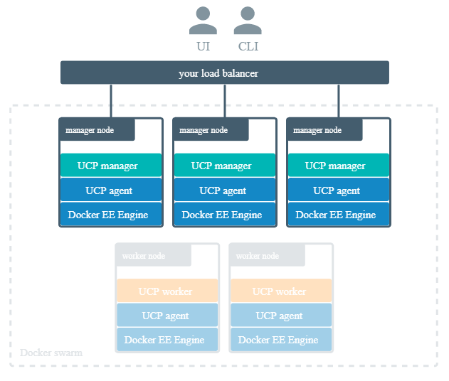
Load Balancer
Source: https://docs.docker.com/ee/ucp/admin/configure/join-nodes/use-a-load-balancer/
Notes:
Explain load balancer using:
After joining the multiple manager nodes for high-availability, you can configure your own load balancer to balance user requests across all manager nodes.
This allows users to access UCP using a centralized domain name. If a manager node goes down, the load balancer can detect that and stop forwarding requests to that node, so that the failure goes unnoticed by users.

Slide 60
Load Balancer
Stop termination of HTTPS connections
Configuring load balancer to:
Load-balance the TCP traffic on ports 443 and 6443
Apply the /_ping endpoint on all the manager node
Notes:
Explain the load balancer
Load-balancing on UCP
Since Docker UCP uses mutual TLS, make sure you configure your load balancer to:
Load-balance TCP traffic on ports 443 and 6443.
Not terminate HTTPS connections.
Use the /_ping endpoint on each manager node, to check if the node is healthy and if it should remain on the load balancing pool or not.

Slide 61
Load Balancing UCP and DTR
UCP
use
443
DTR
How the load balancer is configured to listen on the port 443?
Load balancer can be configured :
Using separate load balancer for UCP and DTR
Using same load balancer but with more than one virtual IP address
Notes:
Explain how the load balancer is configured.
Load balancing UCP and DTR
By default, both UCP and DTR use port 443. If you plan on deploying UCP and DTR, your load balancer needs to distinguish traffic between the two by IP address or port number.
If you want to configure your load balancer to listen on port 443:
Use one load balancer for UCP, and another for DTR,
Use the same load balancer with multiple virtual IPs.
Configure your load balancer to expose UCP or DTR on a port other than 443.

Slide 62
Configuring Load Balancer
Example of configuring the load balancer for UCP:
user nginx;
worker_processes 1;
error_log /var/log/nginx/error.log warn;
pid /var/run/nginx.pid;
events {
worker_connections 1024;
}
}
Contd. in the adjacent box
stream {
upstream ucp_443 {
server <UCP_MANAGER_1_IP>:443 max_fails=2 fail_timeout=30s;
server <UCP_MANAGER_2_IP>:443 max_fails=2 fail_timeout=30s;
server <UCP_MANAGER_N_IP>:443 max_fails=2 fail_timeout=30s;
}
server {
listen 443;
proxy_pass ucp_443;
}
Notes:
Explain and perform:
Configuring load balancer for UCP:
user nginx;
worker_processes 1;
error_log /var/log/nginx/error.log warn;
pid /var/run/nginx.pid;
events {
worker_connections 1024;
}
stream {
upstream ucp_443 {
server <UCP_MANAGER_1_IP>:443 max_fails=2 fail_timeout=30s;
server <UCP_MANAGER_2_IP>:443 max_fails=2 fail_timeout=30s;
server <UCP_MANAGER_N_IP>:443 max_fails=2 fail_timeout=30s;
}
server {
listen 443;
proxy_pass ucp_443;
}
}

Slide 63
Deploying Load Balancer
Load balancer deployment:
Deploying a load balancer is a two-step process:
Create the nginx.conf file
Deploy the load balancer
docker run --detach \
--name ucp-lb \
--restart=unless-stopped \
--publish 443:443 \
--volume ${PWD}/nginx.conf:/etc/nginx/nginx.conf:ro \
nginx:stable-alpine
Notes:
Perform deployment
Load balancer deployment:
# Create the nginx.conf file, then
# deploy the load balancer
docker run --detach \
--name ucp-lb \
--restart=unless-stopped \
--publish 443:443 \
--volume ${PWD}/nginx.conf:/etc/nginx/nginx.conf:ro \
nginx:stable-alpine

Slide 64
Docker Enterprise: Swarm Service
Notes:
One of the many features of Docker Enterprise is Swarm service

Slide 65
Deploy Swarm Service Using UCP
Steps for deploying and removing a service:
Log in to Docker Enterprise UCP
Click on the option Add Nodes that is present at the bottom of UCP
Click on the desired Node Type: Windows and Linux as well as Node Role: Manager and Worker
Copy the Docker CLI command and run it
Click on Swarm and then Services after the addition of Node
Click on Create button on the right
Fill in the required details in order to deploy a service
Click on Create button that is present at the bottom right corner
Check the status of the service
Choose the desired service that has to be removed
Click Action and then Remove
Click Confirm
Note: There should be enough nodes to deploy a Swarm service
Notes:
Perform deployment:
Steps:
Log in to Docker Enterprise UCP
Click on option Add Nodes present at the bottom of UCP
Click on the desired Node Type: Windows and Linux as well as Node Role: Manager and Worker
Copy the Docker CLI command and run it
Click on the Swarm and then Services after the addition of Node
Click on Create button on right hand side
Fill in the required details in order to deploy a service and then click of Create button present at the bottom right corner
Check the status of the service. A working service will show a green circle

Slide 66
Access Control
Notes:
access control

Slide 67
Access Control
Docker UCP provides a feature that is used to grant and manage permissions to enforce access control.
Organizations control who can create and edit container resources in the swarm, such as:
Services
Volumes
Images
Networks
Notes:
explain access control
With Docker Universal Control Plane, you get to control who can create and edit container resources in your swarm, like services, images, networks, and volumes. You can grant and manage permissions to enforce fine-grained access control as needed.

Slide 68
Grant
Users and organizations access swarm resources that can be controlled by creating grants.
Grant contains:
Role
Subject
Resource collection
Notes:
Explain grant
If you’re a UCP administrator, you can create grants to control how users and organizations access swarm resources.
A grant is made up of a subject, a role, and a resource collection..

Slide 69
Grant
Grant defines:
Role
How much access
Who
Set of resources
Resource collection
Subject
Notes:
(continued from previous slide)
A grant defines who (subject) has how much access (role) to a set of resources (collection)

Slide 70
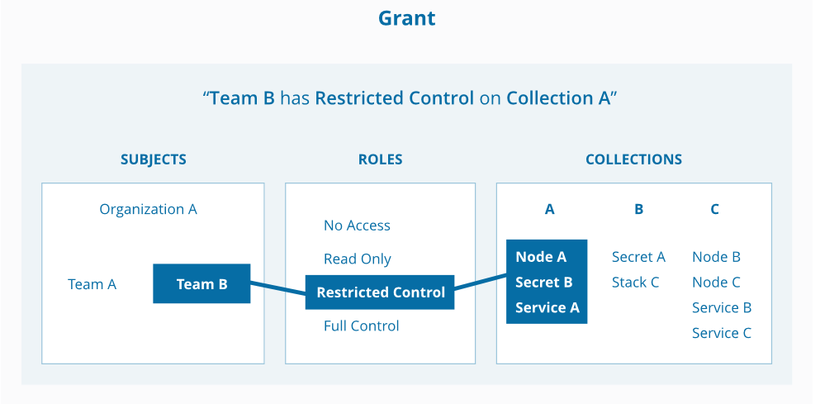
Grant
Example: DevOps team in Simplilearn have restricted control for collection A
Example: DevOps team in Simplilearn have restricted control for collection A
Simplilearn
Node A
Secret B
Service A
Developer team
DevOps team
Restricted control
Source: https://docs.docker.com/datacenter/ucp/2.2/guides/access-control/grant-permissions/
Notes:
Explain example.
An administrator is a user who can manage grants, subjects, roles, and collections. An administrator identifies which operations can be performed against specific resources and who can perform these actions. An administrator can create and manage role assignments against subject in the system. Only an administrator can manage subjects, grants, roles, and collections

Slide 71
Grant: Subject
Notes:
subject

Slide 72
Subject
User
Subjects
Organization
Team
Notes:
Explain subject
A subject represents a user, team, or organization. A subject is granted a role for a collection of resources.
User: A person that the authentication backend validates. You can assign users to one or more teams and one or more organizations.
Organization: A group of users that share a specific set of permissions, defined by the roles of the organization.
Team: A group of users that share a set of permissions defined in the team itself. A team exists only as part of an organization, and all of its members must be members of the organization. Team members share organization permissions. A team can be in one organization only.

Slide 73

Subject
1
2
Administrator
Regular
UCP user
Regular users do not have the privilege to make changes to swarm settings.
Administrator user:
Manages the user permissions by creating grants
Manages the swarm configurations
Notes:
Explain user
In Docker UCP, only users with administrator privileges can make changes to swarm settings. This includes:
Managing user permissions by creating grants.
Managing swarm configurations, like adding and removing nodes.

Slide 74
Create and Manage Teams and Users
Problem Statement: You have been asked by your manager to create users, organization, and teams in Docker UCP that can later be used to create grants.
Steps to Perform:
Create and manage users.
Create and manage an organization.
Create and manage teams in an organization.

Slide 75
Subject
Create a user:
1
Go to the UCP web user interface
2
Navigate to the Users page
3
Click the Create user button
4
Fill in the user information
5
Check the Is a UCP admin?
6
Click the Create button to create the user
Notes:
Perform:
To create a new user, go to the UCP web UI, and navigate to the Users page.
Click the Create user button, and fill-in the user information.
Check the Is a UCP admin? option, if you want to grant permissions for the user to change the swarm configuration and manage grants, roles, and collections.
Finally, click the Create button to create the user.

Slide 76
Subject
Create an organization and team:
Go to the UCP web user interface
Navigate to the Organizations page
Click Create Organization to put a team in a new organization
Name the new organization “Org” (optional)
Click Create to create a organization
Click the organization “Org”
Name the team (description is optional)
Click Create to create a new team
Notes:
Create organization and team
You can extend the user’s default permissions by granting them fine-grained permissions over resources. You do this by adding the user to a team.
To create a new team, go to the UCP web UI, and navigate to the Organizations page.
If you want to put the team in a new organization, click Create Organization and give the new organization a name, like “engineering”.
Click Create to create it.
In the list, click the organization where you want to create the new team. Name the team, give it an optional description, and
click Create to create a new team
You can now add and remove users from the team.
In the current organization’s teams list, click the new team, and in the details pane, click Add Users.
Choose the users that you want to add to the team, and when you’re done, click Add Users.
To sync the team with your organization’s LDAP directory, click Yes.
If UCP is configured to sync users with your organization’s LDAP directory server, you have the option to enable syncing the new team’s members when creating a new team or when modifying settings of an existing team. Enabling this option expands the form with additional fields for configuring the sync of team members.
There are two methods for matching group members from an LDAP directory:
Match Group Members
This option specifies that team members should be synced directly with members of a group in your organization’s LDAP directory. The team’s membership will by synced to match the membership of the group.
Group DN: This specifies the distinguished name of the group from which to select users.
Group Member Attribute: The value of this group attribute corresponds to the distinguished names of the members of the group.
Match Search Results
This option specifies that team members should be synced using a search query against your organization’s LDAP directory. The team’s membership will be synced to match the users in the search results.
Search Base: DNThe distinguished name of the node in the directory tree where the search should start looking for users.
Search Filter: The LDAP search filter used to find users. If you leave this field empty, all existing users in the search scope will be added as members of the team.
Search subtree instead of just one level: Whether to perform the LDAP search on a single level of the LDAP tree, or search through the full LDAP tree starting at the Base DN.
Immediately Sync Team Members
Select this option to run an LDAP sync operation immediately after saving the configuration for the team. It may take a moment before the members of the team are fully synced.

Slide 77
Subject
Create an organization and team:
Click the new team
Click Add Users in the details pane
Choose the users to add it to the team
Click Add Users
Click Yes to Enable Sync Team Members
Choose LDAP Match Method
Choose Immediately Sync Team Members

Slide 78
Grant: Role
Notes:
Role

Slide 79
Role
None
View-only
In-built roles
Restricted control
Scheduler
Full-control
Notes:
Explain role
A role is a set of permitted API operations on a collection that you can assign to a specific user, team, or organization by using a grant.
Explain the built-in roles:
None:
The user has no access to swarm resources. This maps to the No Access role in UCP 2.1.x.
View Only:
The user can view resources like services, volumes, and networks but can’t create them.
Restricted Control:
The user can view and edit volumes, networks, and images but can’t run a service or container in a way that might affect the node where it’s running. The user can’t mount a node directory and can’t exec into containers. Also, The user can’t run containers in privileged mode or with additional kernel capabilities.
Scheduler:
The user can view nodes and schedule workloads on them. Worker nodes and manager nodes are affected by Scheduler grants. Having Scheduler access doesn’t allow the user to view workloads on these nodes. They need the appropriate resource permissions, like Container View. By default, all users get a grant with the Scheduler role against the /Shared collection.
Full Control:
The user can view and edit volumes, networks, and images. They can create containers without any restriction, but can’t see other users’ containers.

Slide 80
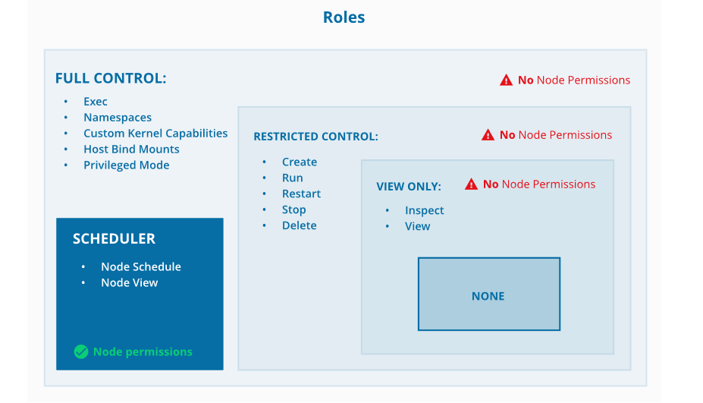
Role
Source: https://docs.docker.com/datacenter/ucp/2.2/guides/access-control/permission-levels/
Notes:
Explain the diagram

Slide 81
Role
Create a custom role:
1
Go to the UCP web user interface
2
Navigate to the Roles page
3
Click Create role
4
Define the API operations that the role uses
5
Give a role a global name
Notes:
Create custom role.
Go to the UCP web user interface
Navigate to the Roles page
(we have already discussed about the default roles, here lets create a custom role)
Click Create role to create a custom role and define the API operations that it uses. When you create a custom role, all of the APIs that you can use are listed on the Create Role page. For example, you can create a custom role that uses the node operations, Schedule, Update, and View, and you might give it a name like “Node Operator”.
You can give a role a global name, like “Remove Images”, which might enable the Remove and Force Remove operations for images. You can apply a role with the same name to different collections.
Only an administrator can create and remove roles. Roles are always enabled. Roles can’t be edited, so to change a role’s API operations, you must delete it and create it again.
You can’t delete a custom role if it’s used in a grant. You must first delete the grants that use the role.

Slide 82
Grant: Resource Collections
Notes:
Resource collection

Slide 83
Collection
What is a collection?
The grouping of swarm cluster resources that are accessed by specifying a directory-like path is known as a collection.
Purpose of a collection:
Collections are used to enable the controlling access to the swarm resources.
Notes:
Explain collection
Docker Enterprise enables controlling access to swarm resources by using collections. A collection is a grouping of swarm cluster resources that you access by specifying a directory-like path.
Swarm resources that can be placed in to a collection include:

Slide 84
Collection
Swarm resources that can be grouped into a collection:
Physical or virtual nodes
Services
Volumes
Application configs
Containers
Networks
Secrets
Notes:
Explain which resources are grouped in a collection
Docker Enterprise enables controlling access to swarm resources by using collections. A collection is a grouping of swarm cluster resources that you access by specifying a directory-like path.
Swarm resources that can be placed in to a collection include:

Slide 85
Collection
Create a collection:
1
Navigate to the Collections page
2
Look for Shared collection and click on View children
3
Click on Create collection and then name the collection as “View-O services”
4
Click Create to create a collection
Notes:
Create collection
Create a collection for the service
Navigate to the Collections page to view all of the resource collections in the swarm.
Find the Shared collection and click View children.
Click Create collection and name the collection “View-only services”.
Click Create to create the collection.
The /Shared/View-O services collection is ready to use for access control.

Slide 86
Granting Permissions
Notes:
Permissions

Slide 87
Create a Grant
Workflow for creating a grant:
Create users and teams
Create separate collections of swarm resources
Grant role-based access to the collections for respective teams
Notes:
Explain grant diagram(revision)
The usual workflow for creating grants has four steps(the 3rd step is optional):
Set up your users and teams. For example, you might want three teams, Dev, QA, and Prod.
Organize swarm resources into separate collections that each team uses.
Optionally, create custom roles for specific permissions to the Docker API. (optional step)
Grant role-based access to collections for your teams

Slide 88
Create a Grant
1
Navigate to the Manage Grants page
2
Click Create Grant
3
Click Select on the desired collection
4
Click Roles and select a role from the dropdown list
5
Click Subjects and choose All Users or Organizations where a user, team, or organization is selected
6
Click Create
Notes:
Create a grant
When you have your users, collections, and roles set up, you can create grants. Administrators create grants on the Manage Grants page.
Click Create Grant. All of the collections in the system are listed.
Click Select on the collection you want to grant access to.
In the left pane, click Roles and select a role from the dropdown list.
In the left pane, click Subjects. Click All Users to create a grant for a specific user, or click Organizations to create a grant for an organization or a team.
Select a user, team, or organization and click Create.

Slide 89
Deploying a Service
Notes:
Deploying a service

Slide 90
Service Deployment
Steps to deploy a service with view-only access:
1
Create an organization and a team
2
Create a collection for the view-only service
3
Deploy a service
4
Create a grant
Source: https://docs.docker.com/datacenter/ucp/3.0/guides/access-control/deploy-view-only-service/
Notes:
High level steps to deploy service
Deploy a service with view-only access across an organization
Problem statement: Your organization is granted access to a new resource collection that contains one service.
Describe the flow diagram

Slide 91
Service Deployment
Step 1: Create an organization, a team, and add a user
1
Log in as an administrator in to UCP
2
Navigate to the Organizations and Teams page
3
Click Create Organization
4
Name the organization as “engineering” and click Create
5
Click Create Team, name the team as “Dev”, and then click Create
6
Add a user to the “Dev” team
Notes:
Create an organization and a team
In this example, you create an organization and a team, and you add one user who isn’t an administrator to the team
Log in to UCP as an administrator.
Navigate to the Organizations & Teams page and click Create Organization. Name the new organization “engineering” and click Create.
Click Create Team, name the new team “Dev”, and click Create.
Add a non-admin user to the Dev team.

Slide 92
Service Deployment
Step 2: Create a collection
1
Navigate to the Collections page
2
Look for Shared collection and click on View children
3
Click on Create collection and then name the collection as “View-O services”
4
Click Create to create a collection
Notes:
Create a collection for the service
Navigate to the Collections page to view all of the resource collections in the swarm.
Find the Shared collection and click View children.
Click Create collection and name the collection “View-only services”.
Click Create to create the collection.
The /Shared/View-O services collection is ready to use for access control.

Slide 93
Service Deployment
Step 3: Deploying a service
1
Navigate to the Services page
2
Create a new service and name it as “WordPress”
3
Enter “wordpress:latest” in the Image textbox
4
Click Collection on the left pane
5
Click View children to get the list of all the collections
6
Click View children in Shared
7
Choose View-only services collection
8
Click Create to add the service to the collection and deploy it
Notes:
Deploy a service
Currently, the new collection has no resources assigned to it. To access resources through this collection, deploy a new service and add it to the collection.
Navigate to the Services page and create a new service, named “WordPress”.
In the Image textbox, enter “wordpress:latest”. This identifies the most recent WordPress image in the Docker Hub.
In the left pane, click Collection. The Swarm collection appears.
Click View children to list all of the collections. In Shared, Click View children, find the View-only services collection and select it.
Click Create to add the “WordPress” service to the collection and deploy it
You’re ready to create a grant for controlling access to the “WordPress” service.

Slide 94
Service Deployment
Step 4: Create grant to give view-only access
1
Navigate to the Grants page
2
Click on Create Grant
3
Click on Collections on the left pane
4
Navigate to /Shared/View-O services
5
Click on Select Collection
6
Click on Roles and select View Only in the dropdown
7
Click on Subjects and then click on Organizations under the Select subject type
8
Select engineering from the dropdown and then click on Create
Notes:
Create a grant
Currently, users who aren’t administrators can’t access the /Shared/View-only services collection. Create a grant to give the engineering organization view-only access.
Navigate to the Grants page and click Create Grant.
In the left pane, click Collections, navigate to /Shared/View-only services, and click Select Collection.
Click Roles, and in the dropdown, select View Only.
Click Subjects, and under Select subject type, click Organizations. In the dropdown, select engineering.
Click Create to grant permissions to the organization.

Slide 95
Service Deployment
Step 5: Verifying the user’s permissions
1
Log in as the Dev team user
2
Navigate to the Services page
3
Click WordPress
4
Confirm the service collection /Shared/View-O services in the details pane
5
Click on the checkbox next to the WordPress service
6
Click Actions and select Remove
Notes:
Verify the user’s permissions
Users in the engineering organization have view-only access to the /Shared/View-only services collection. You can confirm this by logging in as a non-admin user in the organization and trying to delete the service.
Log in as the user who you assigned to the Dev team.
Navigate to the Services page and click WordPress.
In the details pane, confirm that the service’s collection is /Shared/View-only services.
Click the checkbox next to the WordPress service, click Actions, and select Remove. You get an error message, because the user doesn’t have Service Delete access to the collection.

Slide 96
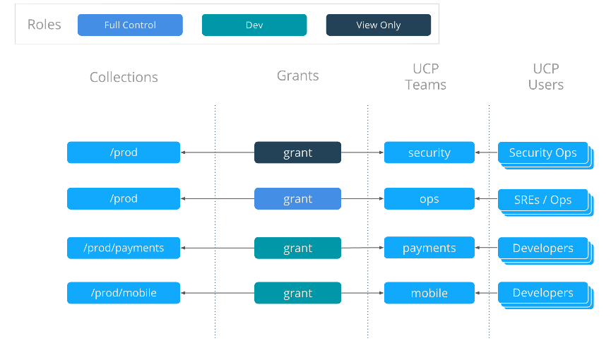
Grant Composition
Source: https://docs.docker.com/datacenter/ucp/3.0/guides/access-control/#grant-composition
Notes:
Explain the diagram
The following four grants define the access policy for the entire organization for this cluster. They tie together the collections that were created, the default and custom roles, and also teams of users that are in UCP.

Slide 97
Docker Trusted Registry (DTR)
Notes:
DTR

Slide 98
Docker Trusted Registry: Overview
Docker Trusted Registry is an image storage solution provided by the Docker. DTR is installed behind the firewall in order to securely store and manage the Docker images that are used in the applications.
Purposes served by DTR from image and job management point of view:
DTR is used as a part of continuous integration and continuous delivery processes to:
Build the applications
Ship the applications
Run the applications
DTR web user interface allows the authorized users in the organization to:
Browse Docker images
Review repository events
DTR allows to see:
Which Dockerfile lines produced the image
Whether security scanning is enabled
The list of all the softwares installed in the images
Notes:
Explain the content on slide using:
Docker Trusted Registry (DTR) is the enterprise-grade image storage solution from Docker. You install it behind your firewall so that you can securely store and manage the Docker images you use in your applications.
Image and job management:
You can use DTR as part of your continuous integration, and continuous delivery processes to build, ship, and run your applications.
DTR has a web user interface that allows authorized users in your organization to browse Docker images and review repository events. It even allows you to see what Dockerfile lines were used to produce the image and, if security scanning is enabled, to see a list of all of the software installed in your images.

Slide 99
Docker Trusted Registry: Overview
Availability of DTR:
It is available during the use of multiple replicas of all the containers and metadata. DTR continues to operate even if the machine fails.
Efficiency of DTR:
DTR efficiently caches the images closer to the user. This reduces the amount of bandwidth required for pulling Docker images.
DTR efficiently cleans up the unreferenced manifests and layers.
Image signing:
DTR ships have built-in Notary that uses Docker Content Trust to sign and verify the images.
Notes:
Explain availability, efficiency, and image signing
Availability
DTR is highly available through the use of multiple replicas of all containers and metadata such that if a machine fails, DTR continues to operate and can be repaired.
Efficiency
DTR has the ability to cache images closer to users to reduce the amount of bandwidth used when pulling Docker images.
DTR has the ability to clean up unreferenced manifests and layers
Image signing
DTR ships with Notary built in so that you can use Docker Content Trust to sign and verify images

Slide 100
Docker Trusted Registry: Overview
Features of built-in access control :
The authentication mechanism used by DTR is the same as the one used by the Docker Universal Control Plane.
Role Based Access Control (RBAC) is used by DTR in order to implement access control policies for the Docker images.
Security features of DTR:
The built-in security scanner is used to discover the versions of software that are used in the images.
The built-in security scans all the layers and aggregates the results for the components that are being shipped as a part of the stack.
The built-in security correlates to the information with a vulnerability database. This provides an unmatched insight of known security threats.
Notes:
Explain Built-in access control features and security features of DTR
DTR uses the same authentication mechanism as Docker Universal Control Plane. Users can be managed manually or synchronized from LDAP or Active Directory. DTR uses Role Based Access Control (RBAC) to allow you to implement fine-grained access control policies for your Docker images.
Security scanning
DTR has a built-in security scanner that can be used to discover what versions of software are used in your images. It scans each layer and aggregates the results to give you a complete picture of what you are shipping as a part of your stack. Most importantly, it correlates this information with a vulnerability database that is kept up to date through periodic updates. This gives you unprecedented insight into your exposure to known security threats.

Slide 101
DTR Architecture
Notes:
DTR architecture

Slide 102
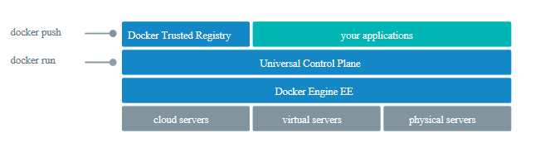
Architecture
DTR is the containerized application, that on deployment uses Docker CLI client to login, push, and pull images.
Notes:
Explain DTR architecture
Docker Trusted Registry (DTR) is a containerized application that runs on a Docker Universal Control Plane cluster.
Once you have DTR deployed, you use your Docker CLI client to login, push, and pull images.

Slide 103
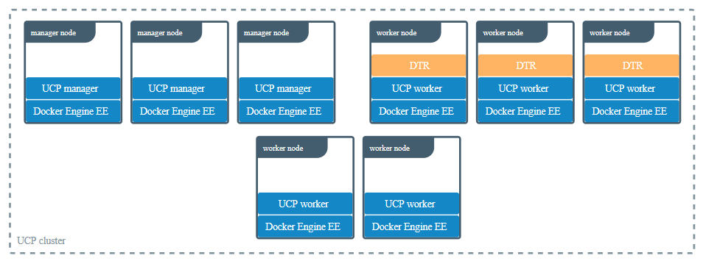
Architecture
Multiple DTR replicas are deployed on the UCP worker nodes to achieve high availability.
Notes:
Explain DTR architecture
For high-availability you can deploy multiple DTR replicas, one on each UCP worker node.
All DTR replicas run the same set of services and changes to their configuration are automatically propagated to other replicas.

Slide 104
DTR Components
Following containers are started after the installation of DTR:
Name | Description
dtr-api-<replica_id> | Executes the DTR business logic
dtr-garant-<replica_id> | Manages the DTR authentication
dtr-jobrunner-<replica_id> | Runs the cleanup jobs in the background
dtr-nginx-<replica_id> | Receives https/http requests and proxies them to other DTR components
dtr-notary-server-<replica_id> | Receives, serves, and validates content trust metadata
dtr-notary-signer-<replica_id> | Performs server-side timestamp and snapshot signing for content trust metadata
dtr-registry-<replica_id> | Implements the functionality for pulling and pushing Docker images
dtr-rethinkdb-<replica_id> | It’s a database for persisting repository metadata
dtr-scanningstore-<replica_id> | Stores security scanning data
Notes:
Explain DTR
Explain the containers.
Name Description
dtr-api-<replica_id> Executes the DTR business logic. It serves the DTR web application, and API
dtr-garant-<replica_id> Manages DTR authentication
dtr-jobrunner-<replica_id> Runs cleanup jobs in the background
dtr-nginx-<replica_id> Receives http and https requests and proxies them to other DTR components. By default it listens to ports 80 and 443 of the host
dtr-notary-server-<replica_id> Receives, validates, and serves content trust metadata, and is consulted when pushing or pulling to DTR with content trust enabled
dtr-notary-signer-<replica_id> Performs server-side timestamp and snapshot signing for content trust metadata
dtr-registry-<replica_id> Implements the functionality for pulling and pushing Docker images. It also handles how images are stored
dtr-rethinkdb-<replica_id> A database for persisting repository metadata
dtr-scanningstore-<replica_id> Stores security scanning data
All these components are for internal use of DTR. Don’t use them in your applications.

Slide 105
Networks and Volumes
Notes:
Networks and volumes

Slide 106
Networks
Networks used:
Networks are created while installing the DTR. This makes the containers capable of communication.
Name | Type | Description
dtr-ol | overlay | It allows communication of DTR components that are running on different nodes. It also allows the replication of DTR data.
Notes:
explain Networks used by DTR
To allow containers to communicate, when installing DTR the following networks are created:
Name Type Description
Dtr-ol overlay Allows DTR components running on different nodes to communicate, to replicate DTR data

Slide 107
Volumes
Volumes used:
Volume name | Description
dtr-ca-<replica_id> | Root key material for the DTR root certificate authority (CA) that issues certificates
dtr-notary-<replica_id> | Certificate and keys for the Notary components
dtr-postgres-<replica_id> | Data of vulnerability scans
dtr-registry-<replica_id> | Data of Docker images (when DTR is configured to store images on the local filesystem)
dtr-rethink-<replica_id> | Repository metadata
dtr-nfs-registry-<replica_id> | Docker images data (when DTR is configured to store images on NFS)
Notes:
explain Volumes used by DTR
DTR uses these named volumes for persisting data:
Volume name Description
dtr-ca-<replica_id> Root key material for the DTR root CA that issues certificates
dtr-notary-<replica_id> Certificate and keys for the Notary components
dtr-postgres-<replica_id> Vulnerability scans data
dtr-registry-<replica_id> Docker images data, if DTR is configured to store images on the local filesystem
dtr-rethink-<replica_id> Repository metadata
dtr-nfs-registry-<replica_id> Docker images data, if DTR is configured to store images on NFS

Slide 108
Image Storage
AWS
2
3
Cleversafe
Storage
1
4
NFS
Google Cloud Storage
6
5
Microsoft Azure
OpenStack Swift
Notes:
List types of storages
By default, Docker Trusted Registry stores images on the filesystem of the node where it is running, but you should configure it to use a centralized storage backend.
DTR supports these storage backends:
NFS
AWS
Cleversafe
Google Cloud Storage
OpenStack Swift
Microsoft Azure

Slide 109
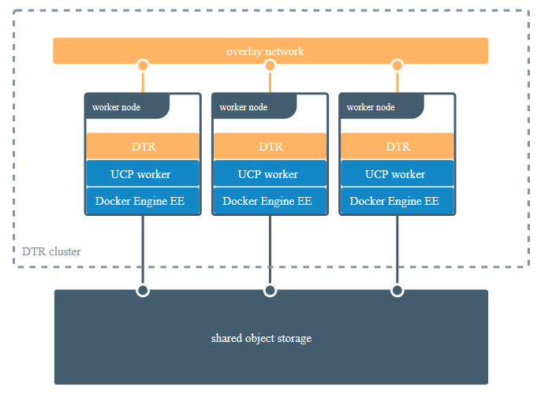
Image Storage
Source: https://docs.docker.com/ee/dtr/architecture/
Notes:
Explain the shared object storage and its use in centralized storage

Slide 110
Installation of DTR
Notes:
Installation of DTR

Slide 111
Installation Requirements
Hardware and software requirements:
Nodes should always be the worker nodes and must be managed by Universal Control Plane
Nodes must have a fixed hostname
Minimum requirements | Recommended production requirements
16GB of RAM for nodes that are running the DTR | 16GB of RAM for nodes that are running the DTR
2 vCPUs for nodes that are running the DTR | 4 vCPUs for nodes that are running the DTR
10GB of free disk space | 25-100GB of free disk space
Notes:
List requirements
Hardware and Software requirements
You can install DTR on-premises or on a cloud provider. To install DTR, all nodes must:
Be a worker node managed by UCP (Universal Control Plane).
Have a fixed hostname.
Minimum requirements
16GB of RAM for nodes running DTR
2 vCPUs for nodes running DTR
10GB of free disk space
Recommended production requirements
16GB of RAM for nodes running DTR
Note that Windows container images are typically larger than Linux ones and for this reason, you should consider provisioning more local storage for Windows nodes and for DTR setups that will store Windows container images.
When image scanning feature is used, we recommend that you have at least 32 GB of RAM. As developers and teams push images into DTR, the repository grows over time so you should inspect RAM, CPU, and disk usage on DTR nodes and increase resources when resource saturation is observed on regular basis.
4 vCPUs for nodes running DTR
25-100GB of free disk space

Slide 112
Installation Requirements
The following ports must remain open on the node where DTR is being installed:
Direction
Port
Purpose
in
80/tcp
Web app and API client access to DTR
Direction
Port
Purpose
in
443/tcp
Web app and API client access to DTR
Notes:
list and explain the Ports used in installation
When installing DTR on a node, make sure the following ports are open on that node:
Direction Port Purpose
In 80/tcp Web app and API client access to DTR.
In 443/tcp Web app and API client access to DTR.These ports are configurable when installing DTR.

Slide 113
Installation Requirements
UCP configuration:
During the installation or backing up of DTR on a UCP cluster, the administrator must deploy containers on “UCP manager nodes or nodes running the DTR.”
If administrators are not deployed on the “UCP manager nodes or the nodes running DTR,” then the DTR installation or backup will fail and display the following error:
Error response from daemon: {"message":"could not find any nodes on which the container could be created"}
Notes:
Mention UCP Configuration:
To configure this two orchestrators can be used: Swarm and Kubernetes
Swarm workloads: (on slide)
When installing or backing up DTR on a UCP cluster, Administrators need to be able to deploy containers on “UCP manager nodes or nodes running DTR”. This setting can be adjusted in the UCP Settings menu.
The DTR installation or backup will fail with the following error message if Administrators are unable to deploy on “UCP manager nodes or nodes running DTR”.
Error response from daemon: {"message":"could not find any nodes on which the container could be created"}
UCP configuration on UCP setting menu
To restrict users from deploying to manager nodes, log in with administrator credentials to the UCP web interface, navigate to the Admin Settings page, and choose Scheduler. You can then choose if user services should be allowed to run on manager nodes or not.
Having a grant with the Scheduler role against the / collection takes precedence over any other grants with Node Schedule on subcollections.
Kubernetes Workloads (not on slide)
By default Universal Control Plane clusters takes advantage of Taints and Tolerations to prevent a User’s workload being deployed on to UCP Manager or DTR Nodes.
You can view this taint by running:
$ kubectl get nodes <ucpmanager> -o json | jq -r '.spec.taints | .[]’
{
"effect": "NoSchedule",
"key": "com.docker.ucp.manager"
}
Kubernetes: Allow Administrators to Schedule on Manager / DTR Nodes
To allow Administrators to deploy workloads accross all nodes types, an Administrator can tick the “Allow administrators to deploy containers on UCP managers or nodes running DTR” box in the UCP web interface.
For all new workloads deployed by Administrators after this box has been ticked, UCP will apply a toleration to your workloads to allow the pods to be scheduled on all node types.
For existing workloads, the Administrator will need to edit the Pod specification, through kubectl edit <object> <workload> or the UCP web interface and add the following toleration:
tolerations:
key: "com.docker.ucp.manager"
operator: "Exists"
You can check this has been applied succesfully by:
$ kubectl get <object> <workload> -o json | jq -r '.spec.template.spec.tolerations | .[]’
{
"key": "com.docker.ucp.manager",
"operator": "Exists“
}
Kubernetes: Allow Users and Service Accounts to Schedule on Manager / DTR Nodes
To allow Kubernetes Users and Service Accounts to deploy workloads accross all node types in your cluster, an Administrator will need to tick “Allow all authenticated users, including service accounts, to schedule on all nodes, including UCP managers and DTR nodes.” in the UCP web interface.
For all new workloads deployed by Kubernetes Users after this box has been ticked, UCP will apply a toleration to your workloads to allow the pods to be scheduled on all node types. For existing workloads, the User would need to edit Pod Specification as detailed above in the “Allow Administrators to Schedule on Manager / DTR Nodes” section.
There is a NoSchedule taint on UCP managers and DTR nodes and if you have scheduling on managers/workers disabled in the UCP scheduling options, then a toleration for that taint will not get applied to the deployments, so they should not schedule on those nodes. Unless the Kube workload is deployed in the kube-system name space.

Slide 114
Installation Requirements
UCP setting: Restricting users from deploying to manager nodes:
1
Log in to the UCP web interface as an administrator
2
Navigate to the Admin Settings page
3
Choose Scheduler
Notes:
UCP Configuration:
To configure this two orchestrators can be used: Swarm and Kubernetes
Swarm workloads: (on slide)
When installing or backing up DTR on a UCP cluster, Administrators need to be able to deploy containers on “UCP manager nodes or nodes running DTR”. This setting can be adjusted in the UCP Settings menu.
The DTR installation or backup will fail with the following error message if Administrators are unable to deploy on “UCP manager nodes or nodes running DTR”.
Error response from daemon: {"message":"could not find any nodes on which the container could be created"}
UCP configuration on UCP setting menu
To restrict users from deploying to manager nodes, log in with administrator credentials to the UCP web interface, navigate to the Admin Settings page, and choose Scheduler. You can then choose if user services should be allowed to run on manager nodes or not.
Having a grant with the Scheduler role against the / collection takes precedence over any other grants with Node Schedule on subcollections.

Slide 115
Install Docker Trusted Registry
Problem Statement: Your manager has asked you to install and set up the Docker Trusted Registry (DTR) so that images can be pushed and scanned for vulnerabilities.
Steps to Perform:
Get DTR install command from Docker Trusted Registry tab in UCP.
Run the command to install DTR.
Login to DTR with admin credentials.

Slide 116
Installation
Post-Installation steps:
Check that the DTR is running:
Navigate to the UCP web interface
Select Shared Resources
Click Stacks
Enter the DTR IP address or FQDN (Fully Qualified Domain Name) on the address bar in order to verify that the DTR is accessible from the browser
Notes:
Explain post installation steps
Verify that DTR is installed.
Either:
See https://<ucp-fqdn>/manage/settings/dtr, or;
Navigate to Admin Settings > Docker Trusted Registry from the UCP web UI. Under the hood, UCP modifies /etc/docker/certs.d for each host and adds DTR’s CA certificate. UCP can then pull images from DTR because the Docker Engine for each node in the UCP swarm has been configured to trust DTR.
Reconfigure your load balancer back to your desired protocol and port.
Step: Check that DTR is running
In your browser, navigate to the UCP web interface.
Select Shared Resources > Stacks from the left navigation pane. You should see DTR listed as a stack.
To verify that DTR is accessible from the browser, enter your DTR IP address or FQDN on the address bar. Since HSTS (HTTP Strict-Transport-Security) header is included in all API responses, make sure to specify the FQDN (Fully Qualified Domain Name) of your DTR prefixed with https://, or your browser may refuse to load the web interface.
Step: Configure DTR
After installing DTR, you should configure:
The certificates used for TLS communication.
Navigate to https://<dtr-url> and log in with your credentials.
Select System from the left navigation pane and scroll down to Domain & Proxies.
Enter your DTR domain name and upload or copy and paste the certificate details:
Load balancer/public address. The domain name clients will use to access DTR.
TLS private key. The server private key.
TLS certificate chain. The server certificate and any intermediate public certificates from your certificate authority (CA). This certificate needs to be valid for the DTR public address and have SANs for all addresses used to reach the DTR replicas, including load balancers.
TLS CA. The root CA public certificate.
Click Save to apply your changes.
The storage backend to store the Docker images

Slide 117
Installation
Post-Installation steps:
Configure the certificates that are used for TLS communication:
Log in to the https://<dtr-url>
Select System and scroll down to Domain and Proxies
Enter DTR domain name and upload:
Load balancer/public address
TLS private key
TLS certification chain
TLS CA
Click Save
Configure the storage backend to store the Docker images:
Log in as an admin into the DTR web interface
Navigate to System
Click Storage
Notes:
continued from previous slide
Step: Configure DTR
After installing DTR, you should configure:
The certificates used for TLS communication.
Navigate to https://<dtr-url> and log in with your credentials.
Select System from the left navigation pane and scroll down to Domain & Proxies.
Enter your DTR domain name and upload or copy and paste the certificate details:
Load balancer/public address. The domain name clients will use to access DTR.
TLS private key. The server private key.
TLS certificate chain. The server certificate and any intermediate public certificates from your certificate authority (CA). This certificate needs to be valid for the DTR public address and have SANs for all addresses used to reach the DTR replicas, including load balancers.
TLS CA. The root CA public certificate.
Click Save to apply your changes.
The storage backend to store the Docker images:
To configure the storage backend, log in to the DTR web interface as an admin, and navigate to System > Storage.
The storage configuration page gives you the most common configuration options, but you have the option to upload a configuration file in .yml, .yaml, or .txt format.
See Docker Registry Configuration for configuration options.
Download the offline package
Use a computer with internet access to download a package with all DTR images:
$ wget <package-url> -O dtr.tar.gz
Now that you have the package in your local machine, you can transfer it to the machines where you want to install DTR.
For each machine where you want to install DTR:
Copy the DTR package to that machine.
$ scp dtr.tar.gz <user>@<host>
Use ssh to log into the hosts where you transferred the package.
Load the DTR images.
Once the package is transferred to the hosts, you can use the docker load command to load the Docker images from the tar archive:
$ docker load -i dtr.tar.gz
Install DTR
Now that the offline hosts have all the images needed to install DTR. Follow the installation instructions as mentioned in previous slides

Slide 118
Installation
Post-Installation steps:
Testing whether the images can be pushed or pulled:
Configure the Ubuntu/Debian operating system to trust the certificate:
Download the DTR CA certificate sudo curl -k https://<dtr-domain-name>/ca -o /usr/local/share/ca-certificates/<dtr-domain-name>.crt
Refresh the list of certificates to trust sudo update-ca-certificates
Restart the Docker daemon sudo service docker restart
Notes:
continued from previous slide
The first step to make your Docker Engine trust the certificate authority used by DTR is to get the DTR CA certificate. Then you configure your operating system to trust that certificate.
Ubuntu/ Debian
# Download the DTR CA certificate
sudo curl -k https://<dtr-domain-name>/ca -o /usr/local/share/ca-certificates/<dtr-domain-name>.crt
# Refresh the list of certificates to trust
sudo update-ca-certificates
# Restart the Docker daemon
sudo service docker restart

Slide 119
Installation
Post-Installation steps:
Testing whether the images can be pushed or pulled:
Create an image repository:
Log in to https://<dtr-url with UCP credentials, if image repository is being created for the first time
Select Repositories on left navigation pane
Click New repository on the upper right corner
Select the namespace and name the repository
Choose the repository type
Click Create to create the repository
Notes:
continued from previous slide
To create an image repository for the first time, log in to https://<dtr-url with your UCP credentials.
Select Repositories from the left navigation pane and click New repository on the upper right corner of the Repositories page.
Select your namespace and enter a name for your repository (upper case letters and some special characters not accepted). You can optionally add a description.
Choose whether your repository is public or private:
Public repositories are visible to all users but can only be changed by users with write permissions to them.
Private repositories can only be seen by users that have been granted permissions to that repository.
Click Create to create the repository.
When creating a repository in DTR, the full name of the repository becomes <dtr-domain-name>/<user-or-org>/<repository-name>. In this example, the full name of our repository will be dtr-example.com/test-user-1/wordpress.
Optional: Click Show advanced settings to make your tags immutable or set your image scanning trigger.

Slide 120
Installation
Post-Installation steps:
Testing whether the images can be pushed or pulled:
Pull an image:
Access the DTR at dtr-example.com (DTR external URL)
Permission is granted to access the nginx and wordpress repositories
Run the following command to pull the latest tag of the wordpress image: docker login dtr-example.com docker pull dtr-example.com/library/wordpress:latest
Notes:
continued from previous slide
Pull an image
Pulling an image from Docker Trusted Registry is the same as pulling an image from Docker Hub or any other registry. Since DTR is secure by default, you always need to authenticate before pulling images. In this example, DTR can be accessed at dtr-example.com (), and the user was granted permissions to access the nginx and wordpress repositories in the library organization.
Click on the repository name to see its details.
To pull the latest tag of the library/wordpress image, run:
docker login dtr-example.com docker pull dtr-example.com/library/wordpress:latest
Push the image
Now that you have tagged the image, you only need to authenticate and push the image to DTR.
docker login dtr-example.com docker push dtr-example.com/library/wordpress:latest
On the web interface, navigate to the Tags tab on the repository page to confirm that the tag was successfully pushed.

Slide 121
Installation
Post-Installation steps:
Testing whether the images can be pushed or pulled:
Push an image:
Tag the image: # Pull from Docker Hub the latest tag of the wordpress image docker pull wordpress:latest # Tag the wordpress:latest image with the full repository name we've created in DTR docker tag wordpress:latest dtr-example.com/library/wordpress:latest
Push the image to DTR:
docker login dtr-example.com
docker push dtr-example.com/library/wordpress:latest
Notes:
continued from previous slide
Pull an image
Pulling an image from Docker Trusted Registry is the same as pulling an image from Docker Hub or any other registry. Since DTR is secure by default, you always need to authenticate before pulling images. In this example, DTR can be accessed at dtr-example.com (), and the user was granted permissions to access the nginx and wordpress repositories in the library organization.
Click on the repository name to see its details.
To pull the latest tag of the library/wordpress image, run:
docker login dtr-example.com docker pull dtr-example.com/library/wordpress:latest
Push the image
Now that you have tagged the image, you only need to authenticate and push the image to DTR.
docker login dtr-example.com docker push dtr-example.com/library/wordpress:latest
On the web interface, navigate to the Tags tab on the repository page to confirm that the tag was successfully pushed.

Slide 122
Installation
Post-Installation steps:
Join the replicas to the cluster:
Load the UCP user bundle
Run command: docker run -it --rm \ docker/dtr:2.7.3 join \ --ucp-node <ucp-node-name> \ --ucp-insecure-tls
Check the existing replicas:
Navigate to UCP web interface
Select Shared Resources
Click Stacks The replicas will be displayed on the console
Notes:
continued from previous slide
Step 5. Join replicas to the cluster (This step is optional.)
To set up DTR for high availability, you can add more replicas to your DTR cluster. Adding more replicas allows you to load-balance requests across all replicas, and keep DTR working if a replica fails.
For high-availability, you should set 3 or 5 DTR replicas. The replica nodes also need to be managed by the same UCP.
To add replicas to a DTR cluster, use the join command:
Load your UCP user bundle. (i.e. client certificate bundle)
Run the join command:
docker run -it --rm \
docker/dtr:2.7.3 join \ --ucp-node <ucp-node-name> \ --ucp-insecure-tls
The <ucp-node-name> following the --ucp-node flag is the target node to install the DTR replica. This is NOT the UCP Manager URL.
When you join a replica to a DTR cluster, you need to specify the ID of a replica that is already part of the cluster. You can find an existing replica ID by going to the Shared Resources > Stacks page on UCP.
Check that all replicas are running. In your browser, navigate to UCP’s web interface. Select Shared Resources > Stacks. All replicas should be displayed.

Slide 123
Uninstallation
Uninstallation step:
Destroy command must be run for every replica:
docker run -it --rm \
docker/dtr:2.7.3 destroy \
--ucp-insecure-tls
Notes:
Explain uninstallation step

Slide 124
DTR: High Availability
Notes:
High availability

Slide 125
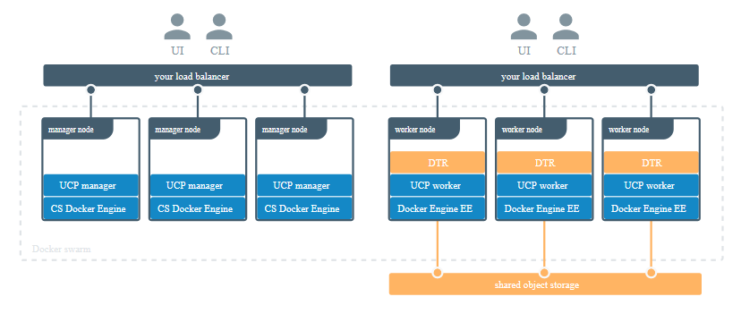
High Availability
Docker Trusted Registry (DTR), an enterprise-grade image storage solution from Docker, is capable of scaling horizontally. As the usage increases, the replicas can be added to make the DTR scale for high availability.
Docker swarm
Notes:
Explain high availability
Docker Trusted Registry (DTR) is the enterprise-grade image storage solution from Docker.
Docker Trusted Registry is designed to scale horizontally as your usage increases. You can add more replicas to make DTR scale to your demand and for high availability.
Explain the diagram

Slide 126
DTR Failure Tolerance
Additional replicas must be added to the Docker Trusted Registry (DTR) cluster in order to make DTR tolerant to failures.
DTR replicas | Failures tolerated
1 | 0
3 | 1
5 | 2
7 | 3
Notes:
Explain failure tolerance with respect to DTR
To make DTR tolerant to failures, add additional replicas to the DTR cluster.

Slide 127
Sizing DTR Installation
Thumb rules to size the DTR installation:
Create a DTR cluster with more than two replicas
Keep the replica online all the time
Add enough number of replicas
The minimum number of nodes required for having high-availability on UCP and DTR:
Dedicated nodes | UCP/DTR/Containers/Applications
3 | For installation of UCP with high availability
3 | For installation of DTR with high availability
n | For running containers and applications
Note: Configure the DTR replicas in order to share the same object storage.
Notes:
Explain sizing DTR installation
When sizing your DTR installation for high-availability, follow these rules of thumb:
Don’t create a DTR cluster with just two replicas. Your cluster won’t tolerate any failures, and it’s possible that you experience performance degradation.
When a replica fails, the number of failures tolerated by your cluster decreases. Don’t leave that replica offline for long.
Adding too many replicas to the cluster might also lead to performance degradation, as data needs to be replicated across all replicas.
To have high-availability on UCP and DTR, you need a minimum of:
3 dedicated nodes to install UCP with high availability,
3 dedicated nodes to install DTR with high availability,
As many nodes as you want for running your containers and applications.
You also need to configure the DTR replicas to share the same object storage.

Slide 128
Add Replicas
Adding replicas to an existing DTR deployment:
Use ssh to log in to a node that is a part of a UCP
Run the following DTR join command:
docker run -it --rm \
docker/dtr:2.7.3 join \
--ucp-node <ucp-node-name> \
--ucp-insecure-tls
Add this DTR replica to the load balancing pool in case the load balancer is available
It is the hostname of the UCP node where the DTR replica is deployed.
It confirms the certificates used by UCP
Notes:
Add replicas to an existing DTR deployment:
Use ssh to log into any node that is already part of UCP.
Run the DTR join command:
docker run -it --rm \
docker/dtr:2.7.3 join \
--ucp-node <ucp-node-name> \
--ucp-insecure-tls
Where the --ucp-node is the hostname of the UCP node where you want to deploy the DTR replica.
--ucp-insecure-tls tells the command to trust the certificates used by UCP.
If you have a load balancer, add this DTR replica to the load balancing pool.

Slide 129
Remove Replicas
Removing replicas from DTR deployment:
Use ssh to log in to any node that is part of a UCP.
Run the following DTR remove command:
docker run -it --rm \
docker/dtr:2.7.3 remove \
--ucp-insecure-tls
Prompts:
Existing replica
Replica id
UCP username and password
Notes:
Remove replicas:
Use ssh to log into any node that is part of UCP.
Run the DTR remove command:
docker run -it --rm \
docker/dtr:2.7.3 remove \
--ucp-insecure-tls
You will be prompted for:
Existing replica id: the id of any healthy DTR replica of that cluster
Replica id: the id of the DTR replica you want to remove. It can be the id of an unhealthy replica
UCP username and password: the administrator credentials for UCP

Slide 130
DTR: Load Balancer
Notes:
Load balancer

Slide 131
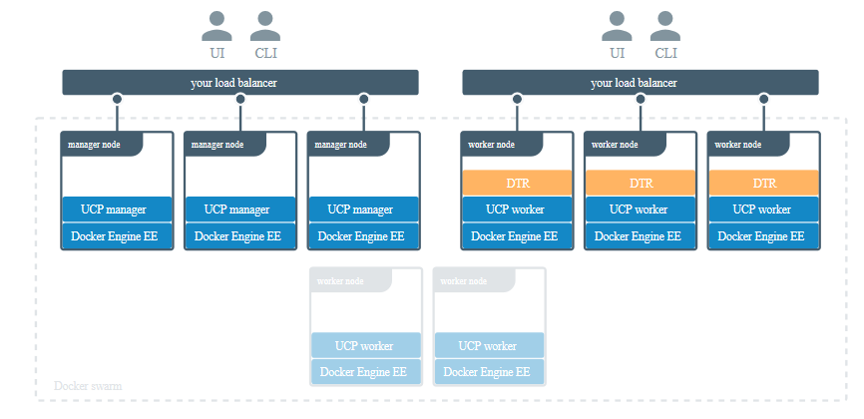
Load Balancer
The load balancer is configured to balance user requests across all replicas. Thus, users can access the DTR using a centralized domain name.
Docker swarm
Notes:
Explain load balancer
Once you’ve joined multiple DTR replicas nodes for high-availability, you can configure your own load balancer to balance user requests across all replicas.
This allows users to access DTR using a centralized domain name. If a replica goes down, the load balancer can detect that and stop forwarding requests to it, so that the failure goes unnoticed by users.
Explain the diagram

Slide 132
Load Balancer
Endpoints are exposed by DTR:
/_ping: Checks the health of DTR replica
/nginx_status: Returns the number of connections being handled by the NGINX front-end used by DTR
/api/v0/meta/cluster_status: Returns extensive information about all DTR replicas
Note: Load balancing service is not provided by DTR. On-premises or a cloud-based load balancer can be used to balance requests across multiple DTR replicas.
Notes:
List endpoints that are exposed by DTR
DTR exposes several endpoints you can use to assess if a DTR replica is healthy or not:
/_ping: Is an unauthenticated endpoint that checks if the DTR replica is healthy. This is useful for load balancing or other automated health check tasks.
/nginx_status: Returns the number of connections being handled by the NGINX front-end used by DTR.
/api/v0/meta/cluster_status: Returns extensive information about all DTR replicas.

Slide 133
Configure Load Balancer
Load balancer must be configured to:
Load balance the TCP traffic on ports 80 and 443
Stop termination of HTTPS connections
Stop buffer requests
Forward the Host HTTP header correctly
Set timeout of more than 10 minutes or set no timeout for idle connections
Notes:
Also, make sure you configure your load balancer to:
Load balance TCP traffic on ports 80 and 443.
Not terminate HTTPS connections.
Not buffer requests.
Forward the Host HTTP header correctly.
Have no timeout for idle connections, or set it to more than 10 minutes.

Slide 134
Health Check of Replicas
Health check:
Command:
/_ping
Output:
{
"Error": "error message",
"Healthy": true
}
true tells that the replica is suitable for taking requests.
Notes:
Explain Health check:
The /_ping endpoint returns a JSON object for the replica being queried of the form:
{ "Error": "error message", "Healthy": true }

Slide 135
Health Check of Replicas
Authorization
Metadata persistence
2
3
503 status for services:
1
4
Storage container
Content trust
Notes:
Explain 503 error
An unhealthy replica will return 503 as the status code and populate "Error" with more details on any one of these services:
Storage container (registry)
Authorization (garant)
Metadata persistence (rethinkdb)
Content trust (notary)

Slide 136
Load Balancer: Configuration and Deployment
Configure load balancer for DTR using NGINX:
user nginx;
worker_processes 1;
error_log /var/log/nginx/error.log warn;
pid /var/run/nginx.pid;
events {
worker_connections 1024;
}
stream {
upstream dtr_80 {
server <DTR_REPLICA_1_IP>:80 max_fails=2 fail_timeout=30s;
server <DTR_REPLICA_2_IP>:80 max_fails=2 fail_timeout=30s;
server <DTR_REPLICA_N_IP>:80 max_fails=2 fail_timeout=30s;
}
Notes:
Configure load balancer with respect to DTR

Slide 137
Load Balancer: Configuration and Deployment
Configure load balancer for DTR using NGINX:
upstream dtr_443 {
server <DTR_REPLICA_1_IP>:443 max_fails=2 fail_timeout=30s;
server <DTR_REPLICA_2_IP>:443 max_fails=2 fail_timeout=30s;
server <DTR_REPLICA_N_IP>:443 max_fails=2 fail_timeout=30s;
}
server {
listen 443;
proxy_pass dtr_443;
}
server {
listen 80;
proxy_pass dtr_80;
}
}
Notes:
continued from previous slide

Slide 138
Load Balancer: Configuration and Deployment
Deploying load balancer using NGINX:
It is a two step process:
Creating file “nginx.conf”
Deploying the load balancer
Command:
docker run --detach \
--name dtr-lb \
--restart=unless-stopped \
--publish 80:80 \
--publish 443:443 \
--volume ${PWD}/nginx.conf:/etc/nginx/nginx.conf:ro \
nginx:stable-alpine
Notes:
Deploy load balancer

Slide 139
UCP: Backup and Restore
Notes:
Moved from Lesson 8

Slide 140
UCP: Backup
Access control
2
3
Certificates and keys
Data
1
4
Configurations
Metrics data
6
5
Volumes
Organizations
Notes:
Explain backing up UCP
Data managed by UCP
Configurations: The UCP cluster configurations, as shown by docker config ls, including Docker Enterprise license and swarm and client CAs
Access control: Permissions for teams to swarm resources, including collections, grants, and roles
Certificates and keys: The certificates, public keys, and private keys that are used for authentication and mutual TLS communication
Metrics data: Monitoring data gathered by UCP
Organizations: Your users, teams, and orgs
Volumes: All UCP named volumes, which include all UCP component certs and data

Slide 141
UCP: Backup
Procedure to create a UCP backup using CLI:
Run the docker/ucp: (latest version) backup command on a single UCP manager
1
2
Replace the latest version with the version the user is currently running
View the backup progress and error reporting
3
4
Verify a UCP Backup
Notes:
Explain the procedure to back up UCP using CLI
Run the docker/ucp:3.2.4 backup command on a single UCP manager and include the --file and --include-logsoptions. This creates a tar archive with the contents of all volumes used by UCP and streams it to stdout. Replace 3.2.4 with the version you are currently running.
VIEW LOG AND PROGRESS INFORMATION
To view backup progress and error reporting, view the contents of the stderr streams of the running backup container during the backup. Progress is updated for each backup step, for example, after validation, after volumes are backed up, after etcd is backed up, and after rethinkDB. Progress is not preserved after the backup has completed.
VERIFY A UCP BACKUP
In a valid backup file, 27 or more files are displayed in the list and the ./ucp-controller-server-certs/key.pem file is present.

Slide 142
UCP: Backup
Procedure to create a UCP backup using UI:
In the UCP UI, navigate to Admin Settings
1
2
Select Backup Admin
Select Backup Now to trigger an immediate backup
3
Notes:
Explain the procedure to back up UCP using UI

Slide 143
UCP: Restore
To restore an existing UCP installation from a backup:
The user needs to uninstall UCP from the swarm by using the uninstall-ucp command.
The user should use the same version of the docker/ucp image that they have used to create the backup while restoring.
The example below shows how to restore UCP from an existing backup file, presumed to be located at /tmp/backup.tar:
$ docker container run --rm -i --name ucp \
-v /var/run/docker.sock:/var/run/docker.sock \
docker/ucp:2.2.22 restore < /tmp/backup.tar
Notes:
Explain the restoring UCP

Slide 144
DTR: Backup and Restore
Notes:
Moved from Lesson 8

Slide 145
DTR: Backup
Repository metadata
2
3
Access control to repository and images
Configurations
1
4
Notary data
Data
Images content
7
5
Scan results
6
Certificates and keys
Notes:
Explain backing up with DTR
Data managed by DTR
Configurations: The DTR cluster configurations Repository metadata: The metadata about the repositories and images deployed Access control to repos and images: Permissions for teams and repositories
Notary data: Notary tags and signatures Scan results: Security scanning results for images Certificates and keys: The certificates, public keys, and private keys that are used for mutual TLS communication
: The images you push to DTR. This can be stored on the filesystem of the node running DTR, or other storage system, depending on the configuration

Slide 146
DTR: Backup
Procedure for DTR backup:
Run DTR Backup command
1
2
Back up DTR image content
Back up DTR metadata
3
4
Verify your backup
Notes:
Explain the procedures of backing up with DTR
Run the DTR backup command (CLI)
FIND YOUR REPLICA ID
Since you need your DTR replica ID during a backup, the following covers a few ways for you to determine your replica ID:
UCP web interface
You can find the list of replicas by navigating to Shared Resources > Stacks or Swarm > Volumes (when using swarm mode) on the UCP web interface.
Back up image content
Since you can configure the storage backend that DTR uses to store images, the way you back up images depends on the storage backend you’re using.
If you’ve configured DTR to store images on the local file system or NFS mount, you can backup the images by using SSH to log in to a DTR node, and creating a tar archive of the dtr-registry volume:
Back up DTR metadata
To create a DTR backup, load your UCP client bundle, and run the following command, replacing the placeholders with real values
Verify your backup
To validate that the backup was correctly performed, you can print the contents of the tar file created.

Slide 147
DTR: Restore
To restore DTR, the user needs to:
Stop any DTR containers that might be running
1
2
Restore the images from a backup
Restore DTR metadata from a backup
3
4
Re-fetch the vulnerability database
Notes:
Explain how to restore DTR
You need to restore DTR on the same UCP cluster where you’ve created the backup. If you restore on a different UCP cluster, all DTR resources will be owned by users that don’t exist, so you can’t manage the resources, even though they’re stored in the DTR data store.
When restoring, you need to use the same version of the docker/dtr image that you’ve used when creating the update. Other versions are not guaranteed to work.

Slide 148
Disaster Recovery
Notes:
Swarm Disaster recovery moved from lesson 8.

Slide 149
UCP Disaster Recovery
Recover swarm from losing the quorum
Uninstall UCP using the uninstall-ucp command, if UCP is still installed on the swarm.
Perform restore from an existing backup on any node:
If there is an existing swarm, the restore operation must be performed on a manager node.
If no swarm exists, the restore operation will create one.
Notes:
Explain UCP Disaster Recovery

Slide 150
UCP Disaster Recovery
Recover a UCP cluster without an existing backup
Perform docker swarm init --force-new-cluster on one of the remaining manager nodes
1
2
Create a backup of the remaining manager node
Uninstall UCP using the uninstall-ucp command if UCP is still installed on the swarm
3
4
Perform a restore on the recovered swarm manager node
Log in to UCP and browse to the nodes page, or use the CLI docker node ls command
5
6
Remove the nodes from the swarm
Create a backup of the restored cluster
7
Notes:
Explain UCP Disaster recovery
On one of the remaining manager nodes, perform docker swarm init --force-new-cluster. You might also need to specify an --advertise-addr parameter, which is equivalent to the --host-address parameter of the docker/ucp install operation. This instantiates a new single-manager swarm by recovering as much state as possible from the existing manager. This is a disruptive operation and existing tasks might be either terminated or suspended.
Create a backup of the remaining manager node.
If UCP is still installed on the swarm, uninstall UCP using the uninstall-ucp command.
Perform a restore on the recovered swarm manager node.
Log in to UCP and browse to the nodes page, or use the CLI docker node ls command.
If any nodes are listed as down, you’ll have to manually remove these nodes from the swarm and then re-join them using a docker swarm join operation with the swarm’s new join-token.
Create a backup of the restored cluster.

Slide 151
DTR Disaster Recovery
Docker Trusted Registry is a clustered application. The user can join multiple replicas for high availability.
To make a DTR cluster healthy, a majority of its replicas (n/2 + 1) need to be healthy and should be able to communicate with the other replicas. This is also known as maintaining quorum.
There are three failure scenarios possible:
Replica is unhealthy but cluster maintains quorum
The majority of replicas are unhealthy
All replicas are unhealthy
Notes:
Explain DTR Disaster Recovery and tell about the failure scenarios

Slide 152
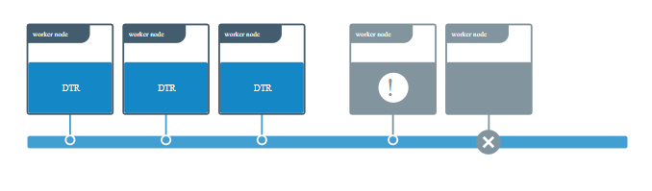
DTR Disaster Recovery
Replica is unhealthy but cluster maintains quorum
One or more replicas are unhealthy, but the overall majority (n/2 + 1) is still healthy and are able to communicate with one another.
Source:: https://docs.docker.com/ee/admin/disaster-recovery/
Notes:
Explain DTR Disaster Recovery where Replica is unhealthy but cluster maintains quorum
In this example the DTR cluster has five replicas but one of the nodes stopped working, and the other has problems with the DTR overlay network.
Even though these two replicas are unhealthy the DTR cluster has a majority of replicas still working, which means that the cluster is healthy.
In this case you should repair the unhealthy replicas, or remove them from the cluster and join new ones.

Slide 153
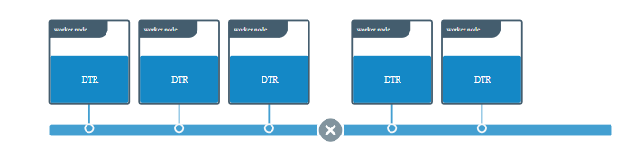
DTR Disaster Recovery
Split-brain scenario
There are five-replicas DTR deployment, and something goes wrong with the overlay network connection the replicas, causing them to be separated in two groups.
Source:: https://docs.docker.com/ee/admin/disaster-recovery/
Notes:
Explain Split-brain scenario
Because the cluster originally had five replicas, it can work as long as three replicas are still healthy and able to communicate (5 / 2 + 1 = 3). Even though the network separated the replicas in two groups, DTR is still healthy.

Slide 154
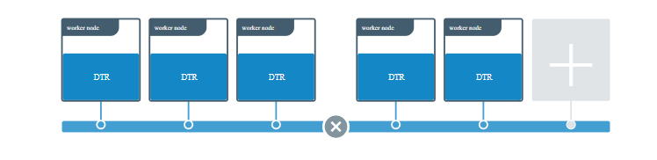
DTR Disaster Recovery
Split-brain scenario
When you join a new replica at this point instead of fixing the network problem or removing the two replicas which have been isolated from the rest, the new replica which end up on the side of the network partition which has less replicas.
Both groups now have the minimum amount of replicas needed to establish a cluster. This is known as a split-brain scenario because both groups can now accept writes, and their histories start to diverge, effectively making the two groups two different clusters.
Source:: https://docs.docker.com/ee/admin/disaster-recovery/

Slide 155
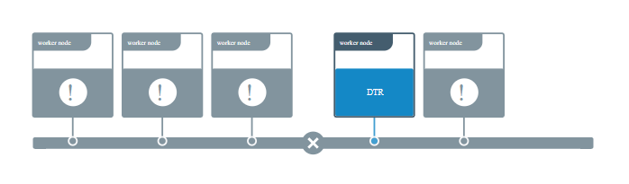
DTR Disaster Recovery
The majority of replicas are unhealthy
If the majority of replicas are unhealthy, but at least one replica is still healthy, or at least the data volumes for DTR are accessible from that replica, the user can repair the cluster without having to restore from a backup. This minimizes the amount of data loss.
Source: https://docs.docker.com/ee/admin/disaster-recovery/
Notes:
Explain DTR Disaster Recovery where the majority of replicase are unhealthy

Slide 156
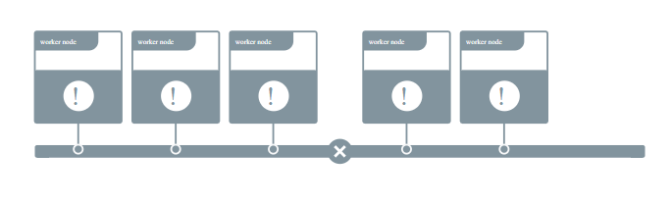
DTR Disaster Recovery
All replicas are unhealthy
This is a total disaster scenario in which all DTR replicas are lost, causing the data volumes for all DTR replicas to get corrupted or lost.
Source: https://docs.docker.com/ee/admin/disaster-recovery/
Notes:
Explain DTR Disaster Recovery where all replicas are unhealthy
In a disaster scenario like this, you’ll have to restore DTR from an existing backup. Restoring from a backup should be only used as a last resort, since doing an emergency repair might prevent some data loss.

Slide 157
Deploy Docker EE for AWS
Notes:
Deploy Docker EE

Slide 158
Deployment Options
Types of Docker for AWS:
Docker Enterprise Edition for AWS
Docker Community Edition for AWS
Deployment options:
Docker for AWS can be deployed with a pre-existing VPC
Docker for AWS can be deployed with a new VPC created by Docker
Notes:
Overview

Slide 159
Prerequisites
SSH key in AWS
2
Access to an AWS account along with permissions to use CloudFormation
AWS account that support EC2-VPC
1
3
Prerequisites
Notes:
List Prerequisites
Access to an AWS account with permissions to use CloudFormation and creating the following objects.
EC2 instances + Auto Scaling groups
IAM profiles
DynamoDB Tables
SQS Queue
VPC + subnets and security groups
ELB
CloudWatch Log Group
SSH key in AWS in the region where you want to deploy (required to access the completed Docker install)
AWS account that support EC2-VPC
For more information about adding an SSH key pair to your account, refer to the Amazon EC2 Key Pairs docs.
The China and US Gov Cloud AWS partitions are not currently supported.

Slide 160
Prerequisites
SQS Queue
DynamoDB Tables
VPC + subnets and security groups
AWS objects
IAM profiles
ELB
EC2 instances + Auto Scaling groups
CloudWatch Log Group
Notes:
continued from previous slide:
Prerequisites
Access to an AWS account with permissions to use CloudFormation and creating the following objects. Full set of required permissions.
EC2 instances + Auto Scaling groups
IAM profiles
DynamoDB Tables
SQS Queue
VPC + subnets and security groups
ELB
CloudWatch Log Group

Slide 161
Mediums and Configurations
Configurations:
Docker for AWS is deployed by using two types of mediums:
AWS Management Console
AWS CLI
During installation the mediums must have the following configuration options:
KeyName | InstanceType
ManagerInstanceType | ClusterSize
EnableSystemPrune | ManagerSize
EnableCloudWatchLogs | WorkerDiskSize
ManagerDiskSize | ManagerDiskType
WorkerDiskType
Notes:
List Configuration
Docker for AWS is installed with a CloudFormation template that configures Docker in swarm mode, running on instances backed by custom AMIs. There are two ways you can deploy Docker for AWS. You can use the AWS Management Console (browser based), or use the AWS CLI. Both have the following configuration options.
KeyName
Pick the SSH key to be used when you SSH into the manager nodes.
InstanceType
The EC2 instance type for your worker nodes.
ManagerInstanceType
The EC2 instance type for your manager nodes. The larger your swarm, the larger the instance size you should use.
ClusterSize
The number of workers you want in your swarm (0-1000).
ManagerSize
The number of managers in your swarm. On Docker Engine - Community, you can select either 1, 3 or 5 managers. We only recommend 1 manager for testing and dev setups. There are no failover guarantees with 1 manager — if the single manager fails the swarm goes down as well. Additionally, upgrading single-manager swarms is not currently guaranteed to succeed.
On Docker EE, you can choose to run with 3 or 5 managers.
We recommend at least 3 managers, and if you have a lot of workers, you should use 5 managers.
EnableSystemPrune
Enable if you want Docker for AWS to automatically cleanup unused space on your swarm nodes.
When enabled, docker system prune runs staggered every day, starting at 1:42AM UTC on both workers and managers. The prune times are staggered slightly so that not all nodes are pruned at the same time. This limits resource spikes on the swarm.
Pruning removes the following:
All stopped containers
All volumes not used by at least one container
All dangling images
All unused networks
EnableCloudWatchLogs
Enable if you want Docker to send your container logs to CloudWatch. (“yes”, “no”) Defaults to yes.
WorkerDiskSize
Size of Workers’ ephemeral storage volume in GiB (20 - 1024).
WorkerDiskType
Worker ephemeral storage volume type (“standard”, “gp2”).
ManagerDiskSize
Size of Manager’s ephemeral storage volume in GiB (20 - 1024)
ManagerDiskType
Manager ephemeral storage volume type (“standard”, “gp2”)
Installing with the AWS Management Console
The simplest way to use the template is to use one of the Quickstart options with the CloudFormation section of the AWS Management Console.

Slide 162
Docker for AWS
Order in which the prerequisites are to be installed:
1
Install Docker EE
2
Install UCP
3
Install DTR
Notes:
Overview

Slide 163
Docker Enterprise Edition for AWS
Adding AWS EC2 user:
Start a Docker service
1
sudo service docker start
Notes:
Perform the steps present on slide

Slide 164
Docker Enterprise Edition for AWS
Adding AWS EC2 user:
Start a Docker service
1
Add the ec2-user to the docker group
2
sudo usermod -a -G docker ec2-user
Notes:
Perform the steps present on slide

Slide 165
Docker Enterprise Edition for AWS
Adding AWS EC2 user:
Start a Docker service
1
Add the ec2-user to the docker group
2
Log out and log back in again
3
Notes:
Perform the steps present on slide

Slide 166
Docker Enterprise Edition for AWS
Adding AWS EC2 user:
Start a Docker service
1
Add the ec2-user to the docker group
2
Log out and log back in again
3
Check that the ec2-user is running Docker commands without using sudo
4
docker info
Notes:
Perform the steps present on slide

Slide 167
Docker Enterprise Edition for AWS
Create a Docker Image:
Create a Dockerfile
1
touch Dockerfile
Notes:
Install Docker on an Amazon EC2 instance
Launch an instance with the Amazon Linux 2 AMI. For more information, see Launching an Instance in the Amazon EC2 User Guide for Linux Instances.
Connect to your instance. For more information, see Connect to Your Linux Instance in the Amazon EC2 User Guide for Linux Instances.
Update the installed packages and package cache on your instance. sudo yum update -y
Install the most recent Docker Community Edition package. sudo amazon-linux-extras install docker
Start the Docker service. sudo service docker start
Add the ec2-user to the docker group so you can execute Docker commands without using sudo. sudo usermod -a -G docker ec2-user
Log out and log back in again to pick up the new docker group permissions. You can accomplish this by closing your current SSH terminal window and reconnecting to your instance in a new one. Your new SSH session will have the appropriate docker group permissions.
Verify that the ec2-user can run Docker commands without sudo. docker info Note In some cases, you may need to reboot your instance to provide permissions for the ec2-user to access the Docker daemon. Try rebooting your instance if you see the following error: Cannot connect to the Docker daemon. Is the docker daemon running on this host?
Create a Docker Image
Amazon ECS task definitions use Docker images to launch containers on the container instances in your clusters. In this section, you create a Docker image of a simple web application, and test it on your local system or EC2 instance, and then push the image to a container registry (such as Amazon ECR or Docker Hub) so you can use it in an ECS task definition.
To create a Docker image of a simple web application
Create a file called Dockerfile. A Dockerfile is a manifest that describes the base image to use for your Docker image and what you want installed and running on it. For more information about Dockerfiles, go to the Dockerfile Reference. touch Dockerfile
Edit the Dockerfile you just created and add the following content. FROM ubuntu:18.04
# Install dependencies
RUN apt-get update && \
apt-get -y install apache2
# Install apache and write hello world message
RUN echo 'Hello World!' > /var/www/html/index.html
# Configure apache
RUN echo '. /etc/apache2/envvars' > /root/run_apache.sh && \
echo 'mkdir -p /var/run/apache2' >> /root/run_apache.sh && \
echo 'mkdir -p /var/lock/apache2' >> /root/run_apache.sh && \
echo '/usr/sbin/apache2 -D FOREGROUND' >> /root/run_apache.sh && \
chmod 755 /root/run_apache.sh
EXPOSE 80
CMD /root/run_apache.sh This Dockerfile uses the Ubuntu 18.04 image. The RUN instructions update the package caches, install some software packages for the web server, and then write the "Hello World!" content to the web server's document root. The EXPOSE instruction exposes port 80 on the container, and the CMD instruction starts the web server.
Build the Docker image from your Dockerfile. Note Some versions of Docker may require the full path to your Dockerfile in the following command, instead of the relative path shown below. docker build -t hello-world .
Run docker images to verify that the image was created correctly. docker images --filter reference=hello-world Output: REPOSITORY TAG IMAGE ID CREATED SIZE
hello-world latest e9ffedc8c286 4 minutes ago 241MB
Run the newly built image. The -p 80:80 option maps the exposed port 80 on the container to port 80 on the host system. For more information about docker run, go to the Docker run reference. docker run -t -i -p 80:80 hello-world Note Output from the Apache web server is displayed in the terminal window. You can ignore the "Could not reliably determine the server's fully qualified domain name" message.
Open a browser and point to the server that is running Docker and hosting your container.
If you are using an EC2 instance, this is the Public DNS value for the server, which is the same address you use to connect to the instance with SSH. Make sure that the security group for your instance allows inbound traffic on port 80.
If you are running Docker locally, point your browser to http://localhost/.
If you are using docker-machine on a Windows or Mac computer, find the IP address of the VirtualBox VM that is hosting Docker with the docker-machine ip command, substituting machine-name with the name of the docker machine you are using. docker-machine ip machine-name
You should see a web page with your "Hello World!" statement.
Stop the Docker container by typing Ctrl + c.

Slide 168
Docker Enterprise Edition for AWS
Create a Docker Image:
Create a Dockerfile
1
FROM ubuntu:18.04
# Install dependencies
RUN apt-get update && \
apt-get -y install apache2
# Install apache and write hello world message
RUN echo 'Hello World!' > /var/www/html/index.html
# Configure apache
RUN echo '. /etc/apache2/envvars' > /root/run_apache.sh && \
echo 'mkdir -p /var/run/apache2' >> /root/run_apache.sh && \
echo 'mkdir -p /var/lock/apache2' >> /root/run_apache.sh && \
echo '/usr/sbin/apache2 -D FOREGROUND' >> /root/run_apache.sh && \
chmod 755 /root/run_apache.sh
EXPOSE 80
CMD /root/run_apache.sh
Edit the Dockerfile by adding the following content
2
Notes:
Install Docker on an Amazon EC2 instance
Launch an instance with the Amazon Linux 2 AMI. For more information, see Launching an Instance in the Amazon EC2 User Guide for Linux Instances.
Connect to your instance. For more information, see Connect to Your Linux Instance in the Amazon EC2 User Guide for Linux Instances.
Update the installed packages and package cache on your instance. sudo yum update -y
Install the most recent Docker Community Edition package. sudo amazon-linux-extras install docker
Start the Docker service. sudo service docker start
Add the ec2-user to the docker group so you can execute Docker commands without using sudo. sudo usermod -a -G docker ec2-user
Log out and log back in again to pick up the new docker group permissions. You can accomplish this by closing your current SSH terminal window and reconnecting to your instance in a new one. Your new SSH session will have the appropriate docker group permissions.
Verify that the ec2-user can run Docker commands without sudo. docker info Note In some cases, you may need to reboot your instance to provide permissions for the ec2-user to access the Docker daemon. Try rebooting your instance if you see the following error: Cannot connect to the Docker daemon. Is the docker daemon running on this host?
Create a Docker Image
Amazon ECS task definitions use Docker images to launch containers on the container instances in your clusters. In this section, you create a Docker image of a simple web application, and test it on your local system or EC2 instance, and then push the image to a container registry (such as Amazon ECR or Docker Hub) so you can use it in an ECS task definition.
To create a Docker image of a simple web application
Create a file called Dockerfile. A Dockerfile is a manifest that describes the base image to use for your Docker image and what you want installed and running on it. For more information about Dockerfiles, go to the Dockerfile Reference. touch Dockerfile
Edit the Dockerfile you just created and add the following content. FROM ubuntu:18.04
# Install dependencies
RUN apt-get update && \
apt-get -y install apache2
# Install apache and write hello world message
RUN echo 'Hello World!' > /var/www/html/index.html
# Configure apache
RUN echo '. /etc/apache2/envvars' > /root/run_apache.sh && \
echo 'mkdir -p /var/run/apache2' >> /root/run_apache.sh && \
echo 'mkdir -p /var/lock/apache2' >> /root/run_apache.sh && \
echo '/usr/sbin/apache2 -D FOREGROUND' >> /root/run_apache.sh && \
chmod 755 /root/run_apache.sh
EXPOSE 80
CMD /root/run_apache.sh This Dockerfile uses the Ubuntu 18.04 image. The RUN instructions update the package caches, install some software packages for the web server, and then write the "Hello World!" content to the web server's document root. The EXPOSE instruction exposes port 80 on the container, and the CMD instruction starts the web server.
Build the Docker image from your Dockerfile. Note Some versions of Docker may require the full path to your Dockerfile in the following command, instead of the relative path shown below. docker build -t hello-world .
Run docker images to verify that the image was created correctly. docker images --filter reference=hello-world Output: REPOSITORY TAG IMAGE ID CREATED SIZE
hello-world latest e9ffedc8c286 4 minutes ago 241MB
Run the newly built image. The -p 80:80 option maps the exposed port 80 on the container to port 80 on the host system. For more information about docker run, go to the Docker run reference. docker run -t -i -p 80:80 hello-world Note Output from the Apache web server is displayed in the terminal window. You can ignore the "Could not reliably determine the server's fully qualified domain name" message.
Open a browser and point to the server that is running Docker and hosting your container.
If you are using an EC2 instance, this is the Public DNS value for the server, which is the same address you use to connect to the instance with SSH. Make sure that the security group for your instance allows inbound traffic on port 80.
If you are running Docker locally, point your browser to http://localhost/.
If you are using docker-machine on a Windows or Mac computer, find the IP address of the VirtualBox VM that is hosting Docker with the docker-machine ip command, substituting machine-name with the name of the docker machine you are using. docker-machine ip machine-name
You should see a web page with your "Hello World!" statement.
Stop the Docker container by typing Ctrl + c.

Slide 169
Docker Enterprise Edition for AWS
Create a Docker Image:
Create a Dockerfile
1
Edit the Dockerfile by adding the following content
2
Build the Docker image from your Dockerfile
3
docker build -t hello-world .
Notes:
Install Docker on an Amazon EC2 instance
Launch an instance with the Amazon Linux 2 AMI. For more information, see Launching an Instance in the Amazon EC2 User Guide for Linux Instances.
Connect to your instance. For more information, see Connect to Your Linux Instance in the Amazon EC2 User Guide for Linux Instances.
Update the installed packages and package cache on your instance. sudo yum update -y
Install the most recent Docker Community Edition package. sudo amazon-linux-extras install docker
Start the Docker service. sudo service docker start
Add the ec2-user to the docker group so you can execute Docker commands without using sudo. sudo usermod -a -G docker ec2-user
Log out and log back in again to pick up the new docker group permissions. You can accomplish this by closing your current SSH terminal window and reconnecting to your instance in a new one. Your new SSH session will have the appropriate docker group permissions.
Verify that the ec2-user can run Docker commands without sudo. docker info Note In some cases, you may need to reboot your instance to provide permissions for the ec2-user to access the Docker daemon. Try rebooting your instance if you see the following error: Cannot connect to the Docker daemon. Is the docker daemon running on this host?
Create a Docker Image
Amazon ECS task definitions use Docker images to launch containers on the container instances in your clusters. In this section, you create a Docker image of a simple web application, and test it on your local system or EC2 instance, and then push the image to a container registry (such as Amazon ECR or Docker Hub) so you can use it in an ECS task definition.
To create a Docker image of a simple web application
Create a file called Dockerfile. A Dockerfile is a manifest that describes the base image to use for your Docker image and what you want installed and running on it. For more information about Dockerfiles, go to the Dockerfile Reference. touch Dockerfile
Edit the Dockerfile you just created and add the following content. FROM ubuntu:18.04
# Install dependencies
RUN apt-get update && \
apt-get -y install apache2
# Install apache and write hello world message
RUN echo 'Hello World!' > /var/www/html/index.html
# Configure apache
RUN echo '. /etc/apache2/envvars' > /root/run_apache.sh && \
echo 'mkdir -p /var/run/apache2' >> /root/run_apache.sh && \
echo 'mkdir -p /var/lock/apache2' >> /root/run_apache.sh && \
echo '/usr/sbin/apache2 -D FOREGROUND' >> /root/run_apache.sh && \
chmod 755 /root/run_apache.sh
EXPOSE 80
CMD /root/run_apache.sh This Dockerfile uses the Ubuntu 18.04 image. The RUN instructions update the package caches, install some software packages for the web server, and then write the "Hello World!" content to the web server's document root. The EXPOSE instruction exposes port 80 on the container, and the CMD instruction starts the web server.
Build the Docker image from your Dockerfile. Note Some versions of Docker may require the full path to your Dockerfile in the following command, instead of the relative path shown below. docker build -t hello-world .
Run docker images to verify that the image was created correctly. docker images --filter reference=hello-world Output: REPOSITORY TAG IMAGE ID CREATED SIZE
hello-world latest e9ffedc8c286 4 minutes ago 241MB
Run the newly built image. The -p 80:80 option maps the exposed port 80 on the container to port 80 on the host system. For more information about docker run, go to the Docker run reference. docker run -t -i -p 80:80 hello-world Note Output from the Apache web server is displayed in the terminal window. You can ignore the "Could not reliably determine the server's fully qualified domain name" message.
Open a browser and point to the server that is running Docker and hosting your container.
If you are using an EC2 instance, this is the Public DNS value for the server, which is the same address you use to connect to the instance with SSH. Make sure that the security group for your instance allows inbound traffic on port 80.
If you are running Docker locally, point your browser to http://localhost/.
If you are using docker-machine on a Windows or Mac computer, find the IP address of the VirtualBox VM that is hosting Docker with the docker-machine ip command, substituting machine-name with the name of the docker machine you are using. docker-machine ip machine-name
You should see a web page with your "Hello World!" statement.
Stop the Docker container by typing Ctrl + c.

Slide 170
Docker Enterprise Edition for AWS
Create a Docker Image:
Create a Dockerfile
1
Edit the Dockerfile by adding the following content
2
Build the Docker image from your Dockerfile
3
Run docker images for verification
4
docker images --filter reference=hello-world
Notes:
Install Docker on an Amazon EC2 instance
Launch an instance with the Amazon Linux 2 AMI. For more information, see Launching an Instance in the Amazon EC2 User Guide for Linux Instances.
Connect to your instance. For more information, see Connect to Your Linux Instance in the Amazon EC2 User Guide for Linux Instances.
Update the installed packages and package cache on your instance. sudo yum update -y
Install the most recent Docker Community Edition package. sudo amazon-linux-extras install docker
Start the Docker service. sudo service docker start
Add the ec2-user to the docker group so you can execute Docker commands without using sudo. sudo usermod -a -G docker ec2-user
Log out and log back in again to pick up the new docker group permissions. You can accomplish this by closing your current SSH terminal window and reconnecting to your instance in a new one. Your new SSH session will have the appropriate docker group permissions.
Verify that the ec2-user can run Docker commands without sudo. docker info Note In some cases, you may need to reboot your instance to provide permissions for the ec2-user to access the Docker daemon. Try rebooting your instance if you see the following error: Cannot connect to the Docker daemon. Is the docker daemon running on this host?
Create a Docker Image
Amazon ECS task definitions use Docker images to launch containers on the container instances in your clusters. In this section, you create a Docker image of a simple web application, and test it on your local system or EC2 instance, and then push the image to a container registry (such as Amazon ECR or Docker Hub) so you can use it in an ECS task definition.
To create a Docker image of a simple web application
Create a file called Dockerfile. A Dockerfile is a manifest that describes the base image to use for your Docker image and what you want installed and running on it. For more information about Dockerfiles, go to the Dockerfile Reference. touch Dockerfile
Edit the Dockerfile you just created and add the following content. FROM ubuntu:18.04
# Install dependencies
RUN apt-get update && \
apt-get -y install apache2
# Install apache and write hello world message
RUN echo 'Hello World!' > /var/www/html/index.html
# Configure apache
RUN echo '. /etc/apache2/envvars' > /root/run_apache.sh && \
echo 'mkdir -p /var/run/apache2' >> /root/run_apache.sh && \
echo 'mkdir -p /var/lock/apache2' >> /root/run_apache.sh && \
echo '/usr/sbin/apache2 -D FOREGROUND' >> /root/run_apache.sh && \
chmod 755 /root/run_apache.sh
EXPOSE 80
CMD /root/run_apache.sh This Dockerfile uses the Ubuntu 18.04 image. The RUN instructions update the package caches, install some software packages for the web server, and then write the "Hello World!" content to the web server's document root. The EXPOSE instruction exposes port 80 on the container, and the CMD instruction starts the web server.
Build the Docker image from your Dockerfile. Note Some versions of Docker may require the full path to your Dockerfile in the following command, instead of the relative path shown below. docker build -t hello-world .
Run docker images to verify that the image was created correctly. docker images --filter reference=hello-world Output: REPOSITORY TAG IMAGE ID CREATED SIZE
hello-world latest e9ffedc8c286 4 minutes ago 241MB
Run the newly built image. The -p 80:80 option maps the exposed port 80 on the container to port 80 on the host system. For more information about docker run, go to the Docker run reference. docker run -t -i -p 80:80 hello-world Note Output from the Apache web server is displayed in the terminal window. You can ignore the "Could not reliably determine the server's fully qualified domain name" message.
Open a browser and point to the server that is running Docker and hosting your container.
If you are using an EC2 instance, this is the Public DNS value for the server, which is the same address you use to connect to the instance with SSH. Make sure that the security group for your instance allows inbound traffic on port 80.
If you are running Docker locally, point your browser to http://localhost/.
If you are using docker-machine on a Windows or Mac computer, find the IP address of the VirtualBox VM that is hosting Docker with the docker-machine ip command, substituting machine-name with the name of the docker machine you are using. docker-machine ip machine-name
You should see a web page with your "Hello World!" statement.
Stop the Docker container by typing Ctrl + c.

Slide 171
Docker Enterprise Edition for AWS
Create a Docker Image:
Create a Dockerfile
1
Edit the Dockerfile by adding the following content
2
Build the Docker image from your Dockerfile
3
Run docker images for verification
4
Run the newly built image
5
docker run -t -i -p 80:80 hello-world
Notes:
Install Docker on an Amazon EC2 instance
Launch an instance with the Amazon Linux 2 AMI. For more information, see Launching an Instance in the Amazon EC2 User Guide for Linux Instances.
Connect to your instance. For more information, see Connect to Your Linux Instance in the Amazon EC2 User Guide for Linux Instances.
Update the installed packages and package cache on your instance. sudo yum update -y
Install the most recent Docker Community Edition package. sudo amazon-linux-extras install docker
Start the Docker service. sudo service docker start
Add the ec2-user to the docker group so you can execute Docker commands without using sudo. sudo usermod -a -G docker ec2-user
Log out and log back in again to pick up the new docker group permissions. You can accomplish this by closing your current SSH terminal window and reconnecting to your instance in a new one. Your new SSH session will have the appropriate docker group permissions.
Verify that the ec2-user can run Docker commands without sudo. docker info Note In some cases, you may need to reboot your instance to provide permissions for the ec2-user to access the Docker daemon. Try rebooting your instance if you see the following error: Cannot connect to the Docker daemon. Is the docker daemon running on this host?
Create a Docker Image
Amazon ECS task definitions use Docker images to launch containers on the container instances in your clusters. In this section, you create a Docker image of a simple web application, and test it on your local system or EC2 instance, and then push the image to a container registry (such as Amazon ECR or Docker Hub) so you can use it in an ECS task definition.
To create a Docker image of a simple web application
Create a file called Dockerfile. A Dockerfile is a manifest that describes the base image to use for your Docker image and what you want installed and running on it. For more information about Dockerfiles, go to the Dockerfile Reference. touch Dockerfile
Edit the Dockerfile you just created and add the following content. FROM ubuntu:18.04
# Install dependencies
RUN apt-get update && \
apt-get -y install apache2
# Install apache and write hello world message
RUN echo 'Hello World!' > /var/www/html/index.html
# Configure apache
RUN echo '. /etc/apache2/envvars' > /root/run_apache.sh && \
echo 'mkdir -p /var/run/apache2' >> /root/run_apache.sh && \
echo 'mkdir -p /var/lock/apache2' >> /root/run_apache.sh && \
echo '/usr/sbin/apache2 -D FOREGROUND' >> /root/run_apache.sh && \
chmod 755 /root/run_apache.sh
EXPOSE 80
CMD /root/run_apache.sh This Dockerfile uses the Ubuntu 18.04 image. The RUN instructions update the package caches, install some software packages for the web server, and then write the "Hello World!" content to the web server's document root. The EXPOSE instruction exposes port 80 on the container, and the CMD instruction starts the web server.
Build the Docker image from your Dockerfile. Note Some versions of Docker may require the full path to your Dockerfile in the following command, instead of the relative path shown below. docker build -t hello-world .
Run docker images to verify that the image was created correctly. docker images --filter reference=hello-world Output: REPOSITORY TAG IMAGE ID CREATED SIZE
hello-world latest e9ffedc8c286 4 minutes ago 241MB
Run the newly built image. The -p 80:80 option maps the exposed port 80 on the container to port 80 on the host system. For more information about docker run, go to the Docker run reference. docker run -t -i -p 80:80 hello-world Note Output from the Apache web server is displayed in the terminal window. You can ignore the "Could not reliably determine the server's fully qualified domain name" message.
Open a browser and point to the server that is running Docker and hosting your container.
If you are using an EC2 instance, this is the Public DNS value for the server, which is the same address you use to connect to the instance with SSH. Make sure that the security group for your instance allows inbound traffic on port 80.
If you are running Docker locally, point your browser to http://localhost/.
If you are using docker-machine on a Windows or Mac computer, find the IP address of the VirtualBox VM that is hosting Docker with the docker-machine ip command, substituting machine-name with the name of the docker machine you are using. docker-machine ip machine-name
You should see a web page with your "Hello World!" statement.
Stop the Docker container by typing Ctrl + c.

Slide 172
Docker Enterprise Edition for AWS
Create a Docker Image:
Create a Dockerfile
1
Edit the Dockerfile by adding the following content
2
Build the Docker image from your Dockerfile
3
Run docker images for verification
4
Run the newly built image
5
Point to the server that is running Docker
6
Notes:
Install Docker on an Amazon EC2 instance
Launch an instance with the Amazon Linux 2 AMI. For more information, see Launching an Instance in the Amazon EC2 User Guide for Linux Instances.
Connect to your instance. For more information, see Connect to Your Linux Instance in the Amazon EC2 User Guide for Linux Instances.
Update the installed packages and package cache on your instance. sudo yum update -y
Install the most recent Docker Community Edition package. sudo amazon-linux-extras install docker
Start the Docker service. sudo service docker start
Add the ec2-user to the docker group so you can execute Docker commands without using sudo. sudo usermod -a -G docker ec2-user
Log out and log back in again to pick up the new docker group permissions. You can accomplish this by closing your current SSH terminal window and reconnecting to your instance in a new one. Your new SSH session will have the appropriate docker group permissions.
Verify that the ec2-user can run Docker commands without sudo. docker info Note In some cases, you may need to reboot your instance to provide permissions for the ec2-user to access the Docker daemon. Try rebooting your instance if you see the following error: Cannot connect to the Docker daemon. Is the docker daemon running on this host?
Create a Docker Image
Amazon ECS task definitions use Docker images to launch containers on the container instances in your clusters. In this section, you create a Docker image of a simple web application, and test it on your local system or EC2 instance, and then push the image to a container registry (such as Amazon ECR or Docker Hub) so you can use it in an ECS task definition.
To create a Docker image of a simple web application
Create a file called Dockerfile. A Dockerfile is a manifest that describes the base image to use for your Docker image and what you want installed and running on it. For more information about Dockerfiles, go to the Dockerfile Reference. touch Dockerfile
Edit the Dockerfile you just created and add the following content. FROM ubuntu:18.04
# Install dependencies
RUN apt-get update && \
apt-get -y install apache2
# Install apache and write hello world message
RUN echo 'Hello World!' > /var/www/html/index.html
# Configure apache
RUN echo '. /etc/apache2/envvars' > /root/run_apache.sh && \
echo 'mkdir -p /var/run/apache2' >> /root/run_apache.sh && \
echo 'mkdir -p /var/lock/apache2' >> /root/run_apache.sh && \
echo '/usr/sbin/apache2 -D FOREGROUND' >> /root/run_apache.sh && \
chmod 755 /root/run_apache.sh
EXPOSE 80
CMD /root/run_apache.sh This Dockerfile uses the Ubuntu 18.04 image. The RUN instructions update the package caches, install some software packages for the web server, and then write the "Hello World!" content to the web server's document root. The EXPOSE instruction exposes port 80 on the container, and the CMD instruction starts the web server.
Build the Docker image from your Dockerfile. Note Some versions of Docker may require the full path to your Dockerfile in the following command, instead of the relative path shown below. docker build -t hello-world .
Run docker images to verify that the image was created correctly. docker images --filter reference=hello-world Output: REPOSITORY TAG IMAGE ID CREATED SIZE
hello-world latest e9ffedc8c286 4 minutes ago 241MB
Run the newly built image. The -p 80:80 option maps the exposed port 80 on the container to port 80 on the host system. For more information about docker run, go to the Docker run reference. docker run -t -i -p 80:80 hello-world Note Output from the Apache web server is displayed in the terminal window. You can ignore the "Could not reliably determine the server's fully qualified domain name" message.
Open a browser and point to the server that is running Docker and hosting your container.
If you are using an EC2 instance, this is the Public DNS value for the server, which is the same address you use to connect to the instance with SSH. Make sure that the security group for your instance allows inbound traffic on port 80.
If you are running Docker locally, point your browser to http://localhost/.
If you are using docker-machine on a Windows or Mac computer, find the IP address of the VirtualBox VM that is hosting Docker with the docker-machine ip command, substituting machine-name with the name of the docker machine you are using. docker-machine ip machine-name
You should see a web page with your "Hello World!" statement.
Stop the Docker container by typing Ctrl + c.

Slide 173
Docker Enterprise Edition for AWS
Create a Docker Image:
Create a Dockerfile
1
Edit the Dockerfile by adding the following content
2
Build the Docker image from your Dockerfile
3
Run docker images for verification
4
Run the newly built image
5
Point to the server that is running Docker
6
Stop the Docker container
Type Ctrl + c
7
Notes:
Install Docker on an Amazon EC2 instance
Launch an instance with the Amazon Linux 2 AMI. For more information, see Launching an Instance in the Amazon EC2 User Guide for Linux Instances.
Connect to your instance. For more information, see Connect to Your Linux Instance in the Amazon EC2 User Guide for Linux Instances.
Update the installed packages and package cache on your instance. sudo yum update -y
Install the most recent Docker Community Edition package. sudo amazon-linux-extras install docker
Start the Docker service. sudo service docker start
Add the ec2-user to the docker group so you can execute Docker commands without using sudo. sudo usermod -a -G docker ec2-user
Log out and log back in again to pick up the new docker group permissions. You can accomplish this by closing your current SSH terminal window and reconnecting to your instance in a new one. Your new SSH session will have the appropriate docker group permissions.
Verify that the ec2-user can run Docker commands without sudo. docker info Note In some cases, you may need to reboot your instance to provide permissions for the ec2-user to access the Docker daemon. Try rebooting your instance if you see the following error: Cannot connect to the Docker daemon. Is the docker daemon running on this host?
Create a Docker Image
Amazon ECS task definitions use Docker images to launch containers on the container instances in your clusters. In this section, you create a Docker image of a simple web application, and test it on your local system or EC2 instance, and then push the image to a container registry (such as Amazon ECR or Docker Hub) so you can use it in an ECS task definition.
To create a Docker image of a simple web application
Create a file called Dockerfile. A Dockerfile is a manifest that describes the base image to use for your Docker image and what you want installed and running on it. For more information about Dockerfiles, go to the Dockerfile Reference. touch Dockerfile
Edit the Dockerfile you just created and add the following content. FROM ubuntu:18.04
# Install dependencies
RUN apt-get update && \
apt-get -y install apache2
# Install apache and write hello world message
RUN echo 'Hello World!' > /var/www/html/index.html
# Configure apache
RUN echo '. /etc/apache2/envvars' > /root/run_apache.sh && \
echo 'mkdir -p /var/run/apache2' >> /root/run_apache.sh && \
echo 'mkdir -p /var/lock/apache2' >> /root/run_apache.sh && \
echo '/usr/sbin/apache2 -D FOREGROUND' >> /root/run_apache.sh && \
chmod 755 /root/run_apache.sh
EXPOSE 80
CMD /root/run_apache.sh This Dockerfile uses the Ubuntu 18.04 image. The RUN instructions update the package caches, install some software packages for the web server, and then write the "Hello World!" content to the web server's document root. The EXPOSE instruction exposes port 80 on the container, and the CMD instruction starts the web server.
Build the Docker image from your Dockerfile. Note Some versions of Docker may require the full path to your Dockerfile in the following command, instead of the relative path shown below. docker build -t hello-world .
Run docker images to verify that the image was created correctly. docker images --filter reference=hello-world Output: REPOSITORY TAG IMAGE ID CREATED SIZE
hello-world latest e9ffedc8c286 4 minutes ago 241MB
Run the newly built image. The -p 80:80 option maps the exposed port 80 on the container to port 80 on the host system.
docker run -t -i -p 80:80 hello-world Note Output from the Apache web server is displayed in the terminal window. You can ignore the "Could not reliably determine the server's fully qualified domain name" message.
Open a browser and point to the server that is running Docker and hosting your container.
If you are using an EC2 instance, this is the Public DNS value for the server, which is the same address you use to connect to the instance with SSH. Make sure that the security group for your instance allows inbound traffic on port 80.
If you are running Docker locally, point your browser to http://localhost/.
If you are using docker-machine on a Windows or Mac computer, find the IP address of the VirtualBox VM that is hosting Docker with the docker-machine ip command, substituting machine-name with the name of the docker machine you are using. docker-machine ip machine-name
You should see a web page with your "Hello World!" statement.
Stop the Docker container by typing Ctrl + c.

Slide 174
Docker Enterprise Edition for AWS
Push an image to Amazon Elastic Container registry:
Required IAM permissions to access the Amazon ECR service
Installed and configured AWS CLI
1
2
Prerequisites
Notes:
Push image to EC2

Slide 175
Docker Enterprise Edition for AWS
Push a “hello-world” image to Amazon Elastic Container registry:
Create an Amazon ECR repository
aws ecr create-repository --repository-name hello-repository --region region
1
Notes:
Push image to EC2
(Optional) Push your image to Amazon Elastic Container Registry
Amazon ECR is a managed AWS Docker registry service. Customers can use the familiar Docker CLI to push, pull, and manage images. For Amazon ECR product details, featured customer case studies, and FAQs, see the Amazon Elastic Container Registry product detail pages.
This section requires the following:
You have the AWS CLI installed and configured. If you do not have the AWS CLI installed on your system, see Installing the AWS Command Line Interface in the AWS Command Line Interface User Guide.
Your user has the required IAM permissions to access the Amazon ECR service. For more information, see Amazon ECR Managed Policies.
To tag your image and push it to Amazon ECR
Create an Amazon ECR repository to store your hello-world image. Note the repositoryUri in the output. aws ecr create-repository --repository-name hello-repository --region region Output: {
"repository": {
"registryId": "aws_account_id",
"repositoryName": "hello-repository",
"repositoryArn": "arn:aws:ecr:region:aws_account_id:repository/hello-repository",
"createdAt": 1505337806.0,
"repositoryUri": "aws_account_id.dkr.ecr.region.amazonaws.com/hello-repository"
}
}
Tag the hello-world image with the repositoryUri value from the previous step. docker tag hello-world aws_account_id.dkr.ecr.region.amazonaws.com/hello-repository
Run the aws ecr get-login --no-include-email command to get the docker login authentication command string for your registry. Note The get-login command is available in the AWS CLI starting with version 1.9.15; however, we recommend version 1.11.91 or later for recent versions of Docker (17.06 or later). You can check your AWS CLI version with the aws --version command. If you are using Docker version 17.06 or later, include the --no-include-email option after get-login. If you receive an Unknown options: --no-include-email error, install the latest version of the AWS CLI. For more information, see Installing the AWS Command Line Interface in the AWS Command Line Interface User Guide. aws ecr get-login --no-include-email --region region
Run the docker login command that was returned in the previous step. This command provides an authorization token that is valid for 12 hours. Important When you execute this docker login command, the command string can be visible to other users on your system in a process list (ps -e) display. Because the docker login command contains authentication credentials, there is a risk that other users on your system could view them this way. They could use the credentials to gain push and pull access to your repositories. If you are not on a secure system, you should consider this risk and log in interactively by omitting the -p password option, and then entering the password when prompted.
Push the image to Amazon ECR with the repositoryUri value from the earlier step. docker push aws_account_id.dkr.ecr.region.amazonaws.com/hello-repository
(Optional) Clean up
When you are done experimenting with your Amazon ECR image, you can delete the repository so you are not charged for image storage.
aws ecr delete-repository --repository-name hello-repository --region region --force

Slide 176
Docker Enterprise Edition for AWS
Push a “hello-world” image to Amazon Elastic Container registry:
Create an Amazon ECR repository
1
Tag the “hello-world” image
2
docker tag hello-world aws_account_id.dkr.ecr.region.amazonaws.com/hello-repository
Notes:
Push image to EC2
(Optional) Push your image to Amazon Elastic Container Registry
Amazon ECR is a managed AWS Docker registry service. Customers can use the familiar Docker CLI to push, pull, and manage images. For Amazon ECR product details, featured customer case studies, and FAQs, see the Amazon Elastic Container Registry product detail pages.
This section requires the following:
You have the AWS CLI installed and configured. If you do not have the AWS CLI installed on your system, see Installing the AWS Command Line Interface in the AWS Command Line Interface User Guide.
Your user has the required IAM permissions to access the Amazon ECR service. For more information, see Amazon ECR Managed Policies.
To tag your image and push it to Amazon ECR
Create an Amazon ECR repository to store your hello-world image. Note the repositoryUri in the output. aws ecr create-repository --repository-name hello-repository --region region Output: {
"repository": {
"registryId": "aws_account_id",
"repositoryName": "hello-repository",
"repositoryArn": "arn:aws:ecr:region:aws_account_id:repository/hello-repository",
"createdAt": 1505337806.0,
"repositoryUri": "aws_account_id.dkr.ecr.region.amazonaws.com/hello-repository"
}
}
Tag the hello-world image with the repositoryUri value from the previous step. docker tag hello-world aws_account_id.dkr.ecr.region.amazonaws.com/hello-repository
Run the aws ecr get-login --no-include-email command to get the docker login authentication command string for your registry. Note The get-login command is available in the AWS CLI starting with version 1.9.15; however, we recommend version 1.11.91 or later for recent versions of Docker (17.06 or later). You can check your AWS CLI version with the aws --version command. If you are using Docker version 17.06 or later, include the --no-include-email option after get-login. If you receive an Unknown options: --no-include-email error, install the latest version of the AWS CLI. For more information, see Installing the AWS Command Line Interface in the AWS Command Line Interface User Guide. aws ecr get-login --no-include-email --region region
Run the docker login command that was returned in the previous step. This command provides an authorization token that is valid for 12 hours. Important When you execute this docker login command, the command string can be visible to other users on your system in a process list (ps -e) display. Because the docker login command contains authentication credentials, there is a risk that other users on your system could view them this way. They could use the credentials to gain push and pull access to your repositories. If you are not on a secure system, you should consider this risk and log in interactively by omitting the -p password option, and then entering the password when prompted.
Push the image to Amazon ECR with the repositoryUri value from the earlier step. docker push aws_account_id.dkr.ecr.region.amazonaws.com/hello-repository
(Optional) Clean up
When you are done experimenting with your Amazon ECR image, you can delete the repository so you are not charged for image storage.
aws ecr delete-repository --repository-name hello-repository --region region --force

Slide 177
Docker Enterprise Edition for AWS
Push a “hello-world” image to Amazon Elastic Container registry:
Create an Amazon ECR repository
1
Tag the “hello-world” image
2
Get the docker login authentication command string
3
aws ecr get-login --no-include-email --region region
Notes:
Push image to EC2
(Optional) Push your image to Amazon Elastic Container Registry
Amazon ECR is a managed AWS Docker registry service. Customers can use the familiar Docker CLI to push, pull, and manage images. For Amazon ECR product details, featured customer case studies, and FAQs, see the Amazon Elastic Container Registry product detail pages.
This section requires the following:
You have the AWS CLI installed and configured. If you do not have the AWS CLI installed on your system, see Installing the AWS Command Line Interface in the AWS Command Line Interface User Guide.
Your user has the required IAM permissions to access the Amazon ECR service. For more information, see Amazon ECR Managed Policies.
To tag your image and push it to Amazon ECR
Create an Amazon ECR repository to store your hello-world image. Note the repositoryUri in the output. aws ecr create-repository --repository-name hello-repository --region region Output: {
"repository": {
"registryId": "aws_account_id",
"repositoryName": "hello-repository",
"repositoryArn": "arn:aws:ecr:region:aws_account_id:repository/hello-repository",
"createdAt": 1505337806.0,
"repositoryUri": "aws_account_id.dkr.ecr.region.amazonaws.com/hello-repository"
}
}
Tag the hello-world image with the repositoryUri value from the previous step. docker tag hello-world aws_account_id.dkr.ecr.region.amazonaws.com/hello-repository
Run the aws ecr get-login --no-include-email command to get the docker login authentication command string for your registry. Note The get-login command is available in the AWS CLI starting with version 1.9.15; however, we recommend version 1.11.91 or later for recent versions of Docker (17.06 or later). You can check your AWS CLI version with the aws --version command. If you are using Docker version 17.06 or later, include the --no-include-email option after get-login. If you receive an Unknown options: --no-include-email error, install the latest version of the AWS CLI. For more information, see Installing the AWS Command Line Interface in the AWS Command Line Interface User Guide. aws ecr get-login --no-include-email --region region
Run the docker login command that was returned in the previous step. This command provides an authorization token that is valid for 12 hours. Important When you execute this docker login command, the command string can be visible to other users on your system in a process list (ps -e) display. Because the docker login command contains authentication credentials, there is a risk that other users on your system could view them this way. They could use the credentials to gain push and pull access to your repositories. If you are not on a secure system, you should consider this risk and log in interactively by omitting the -p password option, and then entering the password when prompted.
Push the image to Amazon ECR with the repositoryUri value from the earlier step. docker push aws_account_id.dkr.ecr.region.amazonaws.com/hello-repository
(Optional) Clean up
When you are done experimenting with your Amazon ECR image, you can delete the repository so you are not charged for image storage.
aws ecr delete-repository --repository-name hello-repository --region region --force

Slide 178
Docker Enterprise Edition for AWS
Push a “hello-world” image to Amazon Elastic Container registry:
Create an Amazon ECR repository
1
Tag the “hello-world” image
2
Get the docker login authentication command string
3
Run the docker login command
4
Notes:
Push image to EC2
(Optional) Push your image to Amazon Elastic Container Registry
Amazon ECR is a managed AWS Docker registry service. Customers can use the familiar Docker CLI to push, pull, and manage images. For Amazon ECR product details, featured customer case studies, and FAQs, see the Amazon Elastic Container Registry product detail pages.
This section requires the following:
You have the AWS CLI installed and configured. If you do not have the AWS CLI installed on your system, see Installing the AWS Command Line Interface in the AWS Command Line Interface User Guide.
Your user has the required IAM permissions to access the Amazon ECR service. For more information, see Amazon ECR Managed Policies.
To tag your image and push it to Amazon ECR
Create an Amazon ECR repository to store your hello-world image. Note the repositoryUri in the output. aws ecr create-repository --repository-name hello-repository --region region Output: {
"repository": {
"registryId": "aws_account_id",
"repositoryName": "hello-repository",
"repositoryArn": "arn:aws:ecr:region:aws_account_id:repository/hello-repository",
"createdAt": 1505337806.0,
"repositoryUri": "aws_account_id.dkr.ecr.region.amazonaws.com/hello-repository"
}
}
Tag the hello-world image with the repositoryUri value from the previous step. docker tag hello-world aws_account_id.dkr.ecr.region.amazonaws.com/hello-repository
Run the aws ecr get-login --no-include-email command to get the docker login authentication command string for your registry. Note The get-login command is available in the AWS CLI starting with version 1.9.15; however, we recommend version 1.11.91 or later for recent versions of Docker (17.06 or later). You can check your AWS CLI version with the aws --version command. If you are using Docker version 17.06 or later, include the --no-include-email option after get-login. If you receive an Unknown options: --no-include-email error, install the latest version of the AWS CLI. For more information, see Installing the AWS Command Line Interface in the AWS Command Line Interface User Guide. aws ecr get-login --no-include-email --region region
Run the docker login command that was returned in the previous step. This command provides an authorization token that is valid for 12 hours. Important When you execute this docker login command, the command string can be visible to other users on your system in a process list (ps -e) display. Because the docker login command contains authentication credentials, there is a risk that other users on your system could view them this way. They could use the credentials to gain push and pull access to your repositories. If you are not on a secure system, you should consider this risk and log in interactively by omitting the -p password option, and then entering the password when prompted.
Push the image to Amazon ECR with the repositoryUri value from the earlier step. docker push aws_account_id.dkr.ecr.region.amazonaws.com/hello-repository
(Optional) Clean up
When you are done experimenting with your Amazon ECR image, you can delete the repository so you are not charged for image storage.
aws ecr delete-repository --repository-name hello-repository --region region --force

Slide 179
Docker Enterprise Edition for AWS
Push a “hello-world” image to Amazon Elastic Container registry:
Create an Amazon ECR repository
1
Tag the “hello-world” image
2
Get the docker login authentication command string
3
Run the docker login command
4
Push the image to Amazon ECR with the repositoryUri value
5
docker push aws_account_id.dkr.ecr.region.amazonaws.com/hello-repository
Notes:
Push image to EC2
(Optional) Push your image to Amazon Elastic Container Registry
Amazon ECR is a managed AWS Docker registry service. Customers can use the familiar Docker CLI to push, pull, and manage images. For Amazon ECR product details, featured customer case studies, and FAQs, see the Amazon Elastic Container Registry product detail pages.
This section requires the following:
You have the AWS CLI installed and configured. If you do not have the AWS CLI installed on your system, see Installing the AWS Command Line Interface in the AWS Command Line Interface User Guide.
Your user has the required IAM permissions to access the Amazon ECR service. For more information, see Amazon ECR Managed Policies.
To tag your image and push it to Amazon ECR
Create an Amazon ECR repository to store your hello-world image. Note the repositoryUri in the output. aws ecr create-repository --repository-name hello-repository --region region Output: {
"repository": {
"registryId": "aws_account_id",
"repositoryName": "hello-repository",
"repositoryArn": "arn:aws:ecr:region:aws_account_id:repository/hello-repository",
"createdAt": 1505337806.0,
"repositoryUri": "aws_account_id.dkr.ecr.region.amazonaws.com/hello-repository"
}
}
Tag the hello-world image with the repositoryUri value from the previous step. docker tag hello-world aws_account_id.dkr.ecr.region.amazonaws.com/hello-repository
Run the aws ecr get-login --no-include-email command to get the docker login authentication command string for your registry. Note The get-login command is available in the AWS CLI starting with version 1.9.15; however, we recommend version 1.11.91 or later for recent versions of Docker (17.06 or later). You can check your AWS CLI version with the aws --version command. If you are using Docker version 17.06 or later, include the --no-include-email option after get-login. If you receive an Unknown options: --no-include-email error, install the latest version of the AWS CLI. For more information, see Installing the AWS Command Line Interface in the AWS Command Line Interface User Guide. aws ecr get-login --no-include-email --region region
Run the docker login command that was returned in the previous step. This command provides an authorization token that is valid for 12 hours. Important When you execute this docker login command, the command string can be visible to other users on your system in a process list (ps -e) display. Because the docker login command contains authentication credentials, there is a risk that other users on your system could view them this way. They could use the credentials to gain push and pull access to your repositories. If you are not on a secure system, you should consider this risk and log in interactively by omitting the -p password option, and then entering the password when prompted.
Push the image to Amazon ECR with the repositoryUri value from the earlier step. docker push aws_account_id.dkr.ecr.region.amazonaws.com/hello-repository
(Optional) Clean up
When you are done experimenting with your Amazon ECR image, you can delete the repository so you are not charged for image storage.
aws ecr delete-repository --repository-name hello-repository --region region --force

Slide 180
Docker Enterprise Edition for AWS
Push a “hello-world” image to Amazon Elastic Container registry:
Create an Amazon ECR repository
1
Tag the “hello-world” image
2
Get the docker login authentication command string
3
Run the docker login command
4
Push the image to Amazon ECR with the repositoryUri value
5
Delete the repository
6
aws ecr delete-repository --repository-name hello-repository --region region --force
Notes:
Push image to EC2
(Optional) Push your image to Amazon Elastic Container Registry
Amazon ECR is a managed AWS Docker registry service. Customers can use the familiar Docker CLI to push, pull, and manage images. For Amazon ECR product details, featured customer case studies. This section requires the following:
You have the AWS CLI installed and configured. If you do not have the AWS CLI installed on your system, see Installing the AWS Command Line Interface in the AWS Command Line Interface User Guide.
Your user has the required IAM permissions to access the Amazon ECR service. For more information, see Amazon ECR Managed Policies.
To tag your image and push it to Amazon ECR
Create an Amazon ECR repository to store your hello-world image. Note the repositoryUri in the output. aws ecr create-repository --repository-name hello-repository --region region Output: {
"repository": {
"registryId": "aws_account_id",
"repositoryName": "hello-repository",
"repositoryArn": "arn:aws:ecr:region:aws_account_id:repository/hello-repository",
"createdAt": 1505337806.0,
"repositoryUri": "aws_account_id.dkr.ecr.region.amazonaws.com/hello-repository"
}
}
Tag the hello-world image with the repositoryUri value from the previous step. docker tag hello-world aws_account_id.dkr.ecr.region.amazonaws.com/hello-repository
Run the aws ecr get-login --no-include-email command to get the docker login authentication command string for your registry. Note The get-login command is available in the AWS CLI starting with version 1.9.15; however, we recommend version 1.11.91 or later for recent versions of Docker (17.06 or later). You can check your AWS CLI version with the aws --version command. If you are using Docker version 17.06 or later, include the --no-include-email option after get-login. If you receive an Unknown options: --no-include-email error, install the latest version of the AWS CLI. For more information, see Installing the AWS Command Line Interface in the AWS Command Line Interface User Guide. aws ecr get-login --no-include-email --region region
Run the docker login command that was returned in the previous step. This command provides an authorization token that is valid for 12 hours. Important When you execute this docker login command, the command string can be visible to other users on your system in a process list (ps -e) display. Because the docker login command contains authentication credentials, there is a risk that other users on your system could view them this way. They could use the credentials to gain push and pull access to your repositories. If you are not on a secure system, you should consider this risk and log in interactively by omitting the -p password option, and then entering the password when prompted.
Push the image to Amazon ECR with the repositoryUri value from the earlier step. docker push aws_account_id.dkr.ecr.region.amazonaws.com/hello-repository
(Optional) Clean up
When you are done experimenting with your Amazon ECR image, you can delete the repository so you are not charged for image storage.
aws ecr delete-repository --repository-name hello-repository --region region --force

Slide 181
Docker EE possesses capabilities, such as image management, container app management, and image security scanning.
UCP-agent is a globally scheduled service that starts running after the deployment of UCP. UCP provides the capability of joining multiple manager nodes to the cluster to counter the failure of the manager node.
Docker Trusted Registry (DTR), provides image storing ability to Docker Enterprise. On increased usage, the replicas are added to make the DTR scale for high availability.
Caching the images closer to the user helps in reducing the bandwidth required for pulling Docker images.
Notes:
Read the points

Slide 183
Choose the minimum requirements to install UCP for manager nodes. (Select all that apply.)
1
8GB of RAM
4GB of RAM
2 vCPUs
600MB of free disk space

Slide 184
Choose the minimum requirements to install UCP for manager nodes. (Select all that apply.)
1
8GB of RAM
4GB of RAM
2 vCPUs
600MB of free disk space
a and c.
The minimum requirements to install UCP for manager nodes are 8GB of RAM and 2 vCPUs.

Slide 185
How do you configure load balancer on UCP? (Select all that apply.)
2
Load-balance the TCP traffic on ports 432 and 6447
Stop termination of HTTPS connections
Create a docker-cofile mpose.yml
Apply the /_ping endpoint on all the manager nodes

Slide 186
How do you configure load balancer on UCP? (Select all that apply.)
2
Load-balance the TCP traffic on ports 432 and 6447
Stop termination of HTTPS connections
Create a docker-cofile mpose.yml
Apply the /_ping endpoint on all the manager nodes
a, b, and d.
You can configure load-balancing on UCP by stopping termination of HTTPS connections, applying the /_ping
endpoint on all the manager node, and load-balancing the TCP traffic on ports 443 and 6443.

Slide 187
What does Grant contain? (Select all that apply.)
3
Role
Subject
User
Resource collection

Slide 188
What does Grant contain? (Select all that apply.)
3
Role
Subject
User
Resource collection
a, b, and d.
Grant contains role, subject, and resource collection.

Slide 189
Which port is used by UCP and DTR by default?
4
434
444
443
433

Slide 190
Which port is used by UCP and DTR by default?
4
434
444
443
433
c.
Both UCP and DTR use port 443 by default.

Slide 191
What are the container resources in the swarm that organizations control? (Select
all that apply.)
4
434
Services
444
Notary data
443
Images
433
Volumes

Slide 192
What are the container resources in the swarm that organizations control? (Select
all that apply.)
5
Services
Notary data
Images
Volumes
a, c, and d.
Organizations control who can create and edit container resources in the swarm, such as services, images,
networks, and volumes.

Slide 193
Using UCP to Add Subjects and Use Shared Resources
Problem Statement: Your team lead has asked you to create an organization and a team on Docker UCP and then add your team members to it. You must create a custom role with write access and group the swarm cluster resource by creating a collection. You are also required to deploy a service and create a grant for it.
Steps to Perform:
Create an organization, a team, and three users.
Create a custom role with complete access.
Create a collection to group the swarm cluster resources.
Create a service and deploy it with a container.
Create a grant to verify user permissions for the deployed service.

